Slide 1
Lingotek + Drupal:
The Power to Translate is Now Inside Drupal
Bull Weber
Director of Sales
Lingotek
Notes:
Introducing Lingotek THE TRANSLATION NETWORK

Slide 2
Today’s Agenda
Introduction to Lingotek
Today’s challenges with multilingual sites
A flexible, agile solution – INSIDE DRUPAL!
High-level tour of Lingotek Translation module:
Installation and set-up
Quick look at some workflows
Case Studies
Q&A

Slide 3
Introducing Lingotek
Founded in 2006
Based in Salt Lake City, Utah
Focus is cloud-based Translation Management System (TMS) that enables continuous multilingual content synchronization
Deep integration with Drupal via Lingotek Translation module
Extensive and highly capable Professional Translation services group compliments core software offering
Notes:
Agenda

Slide 4
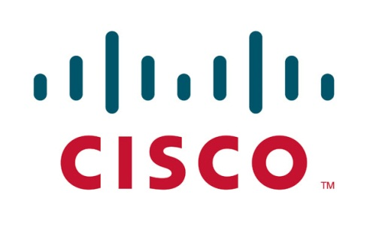
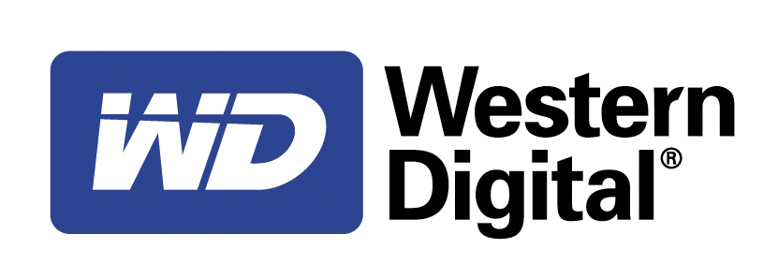
A Few of Our Clients…
Federal Government
Notes:
Collaborative Translation Platform - Now

Slide 5
The Challenge
Today’s highly dynamic websites are characterized by an accelerating and virtually continuous cycle of content updates and changes.
Legacy processes for managing translation workflows lack the speed and agility to keep multilingual websites in sync.

Slide 6
Legacy Translation Process

Slide 7
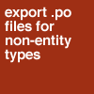
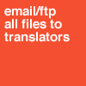
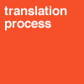
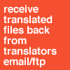
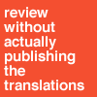
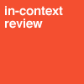
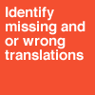
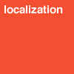
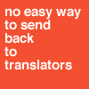
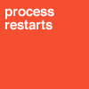
Everyone else makes you do it the HARD way...

Slide 8
Everyone else makes you do it the HARD way...

Slide 9
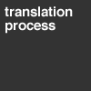
How HARD can it really be?

Slide 10
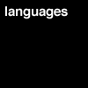
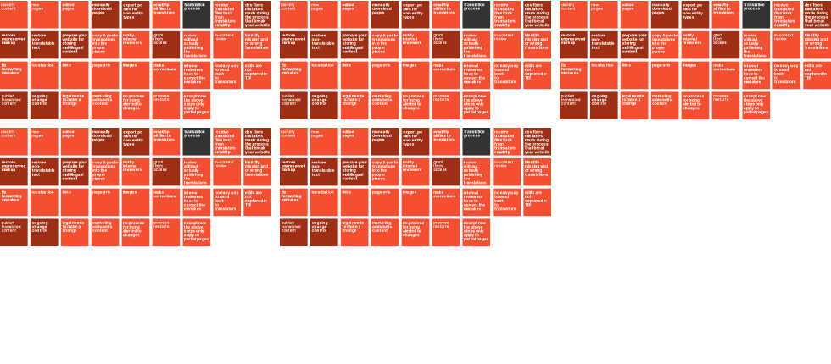
How HARD can it really be?

Slide 11
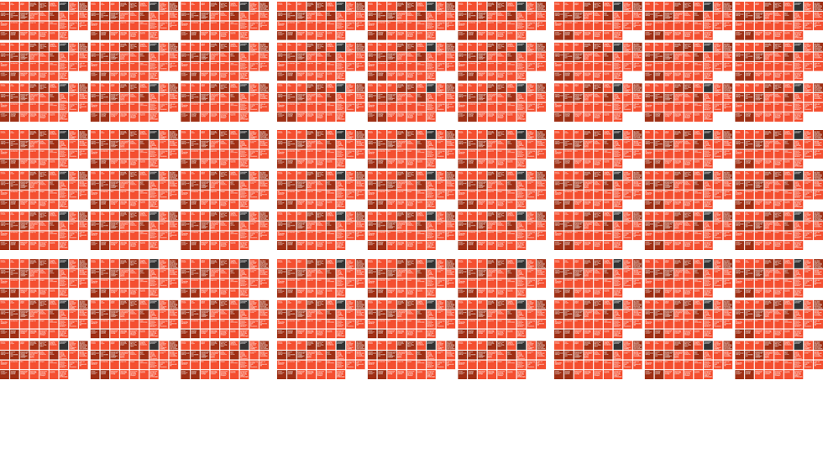
How HARD can it really be?

Slide 12
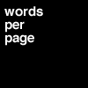
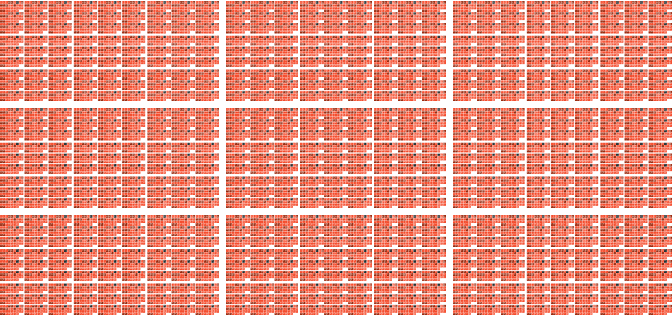
How HARD can it really be?

Slide 13
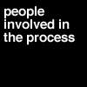
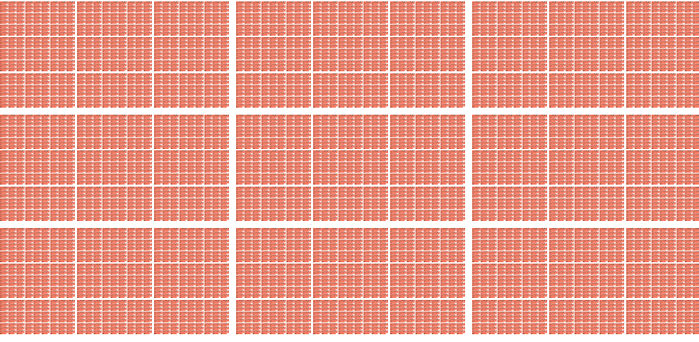
How HARD can it really be?

Slide 14
How HARD can it really be?

Slide 15
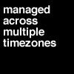
How HARD can it really be?

Slide 16
How HARD can it really be?
Insufficient manhours available
to keep up with the pace
and volume of change

Slide 17
How HARD can it really be?
Too many manual steps
in translation process

Slide 18
How HARD can it really be?
Not Enough Automation

Slide 19
Solution
Lingotek
We provide customers with a flexible, automated solution for managing their multilingual content workflows – saving them time, money and mistakes.
Notes:
Lingotek’s – The Translation Network
Lingotek | The Translation Network helps your business access new markets and customers.
We do this by providing Inside Content Management System modules, a sophisticated translation management system and a professional translation services network.

Slide 20
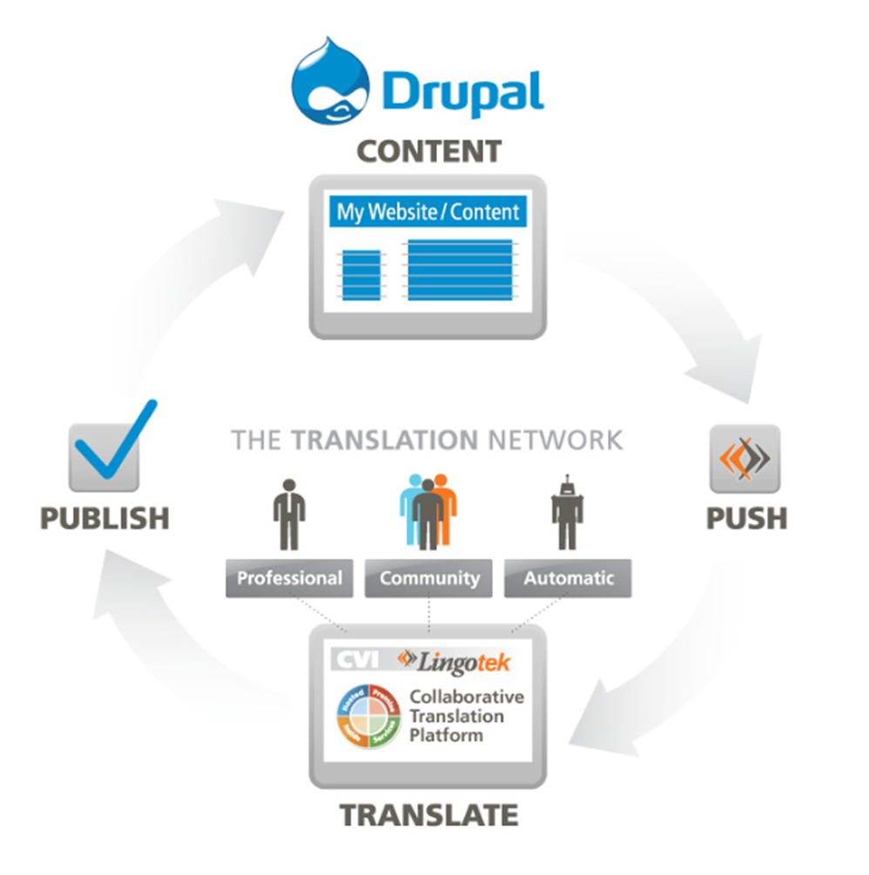
Enabling Continuous Multilingual Publishing
Notes:
Lingotek’s Collaboration Translation Platform
We provide
Services - Translation Services
Hosted - SaaS Marketplace
Premise - Software Sales
Inside - API embed anywhere

Slide 21
Automated Workflows
Content Value Index
Notes:
Content Value Index
Three levels of Trusted Translation
Automatic
Sometimes the general meaning of a text is all you need or want from your translation. In these cases, machine translation provides the perfect combination of speed, accuracy and cost.
Community
Your users are often the best available experts on your global message. Transcreating with community users provides colloquial and subject matter accuracy for lower cost and reasonable speed.
Professional
Using paid experts is sometimes the correct choice for certain kinds of material such as official publications. The right technology, workflow, and project management practices minimize time/cost and maximize content reusability.

Slide 22
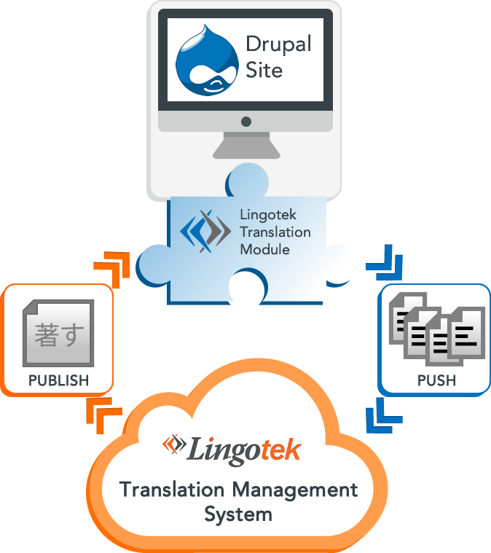

Slide 26
Setup and Initial Translation
Install
Installing the Lingotek Translation Module and Enabling it
Configure
Setting up your account and system settings for Multilingual content.
Machine Translate
Selecting a language and Machine Translating your entire website.
Enjoy!
See the Website in English and Spanish!

Slide 27
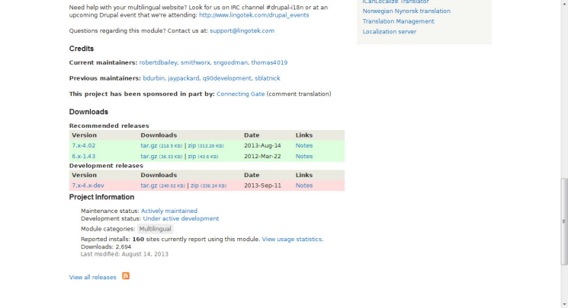
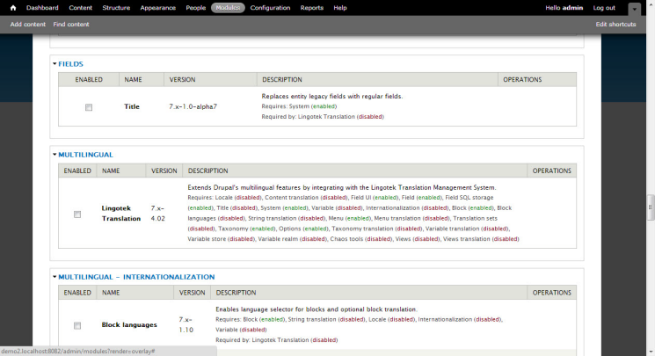
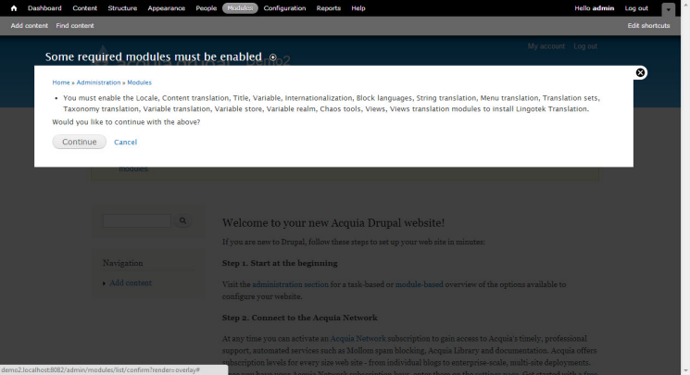
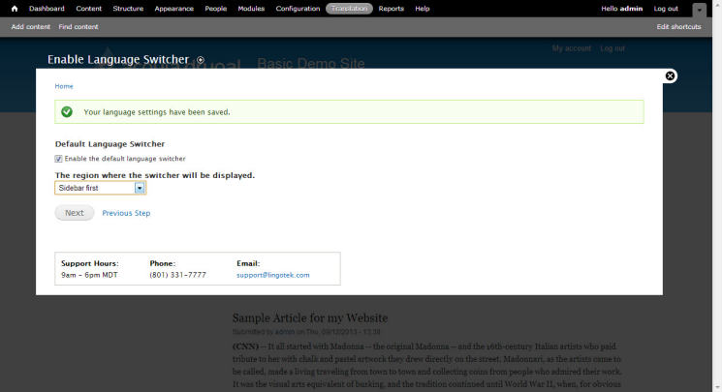
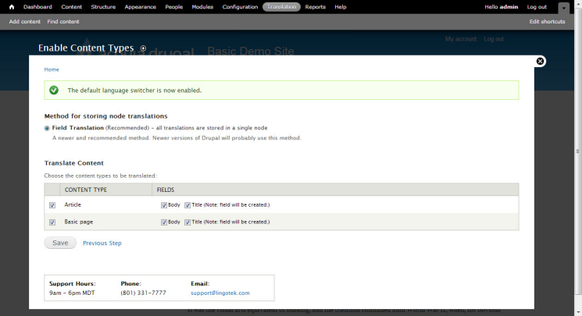
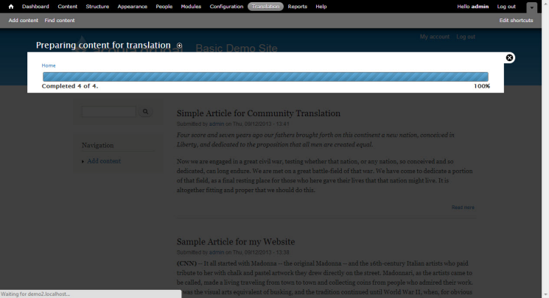
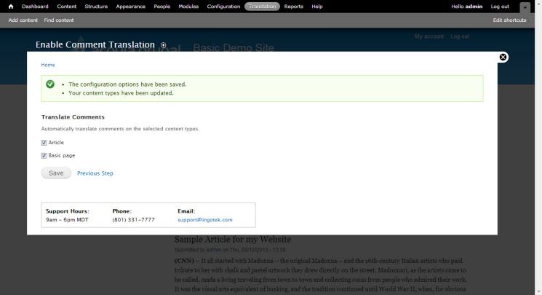
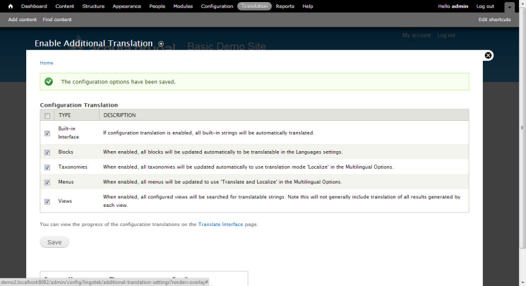
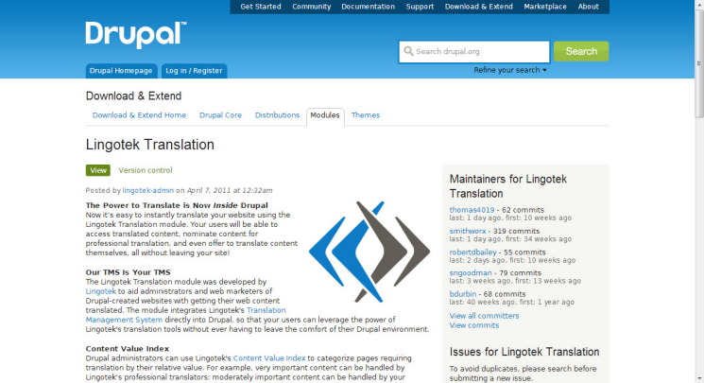
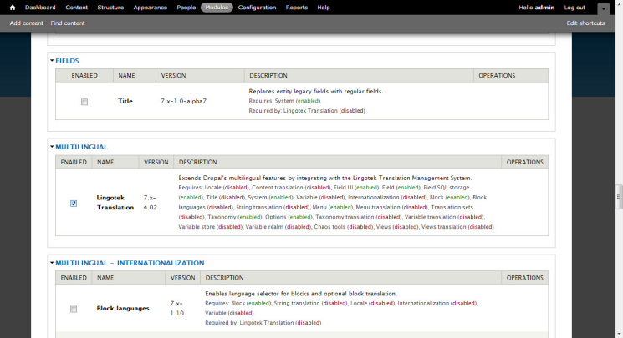
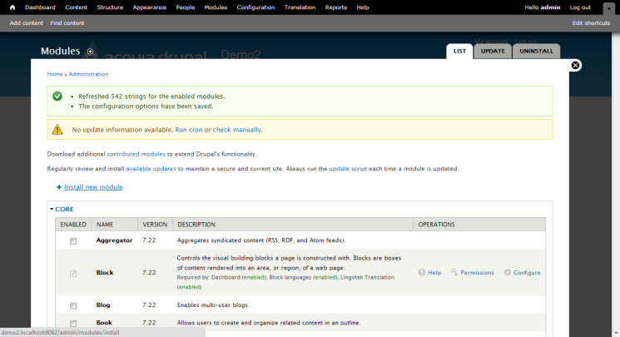
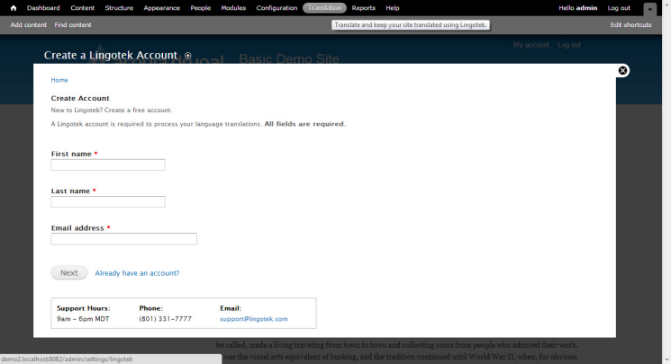
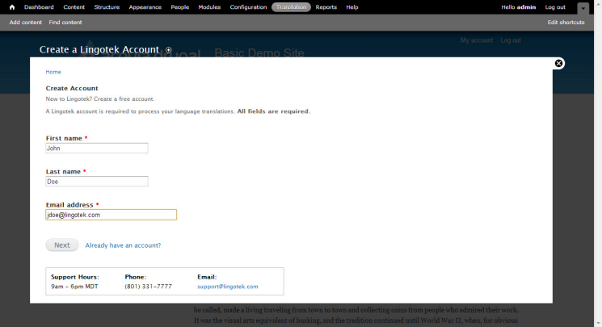
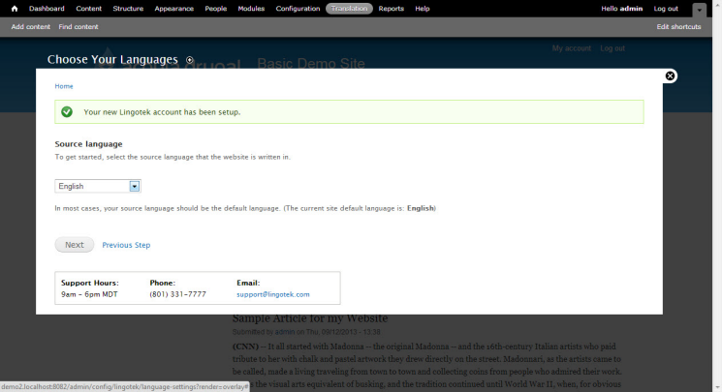
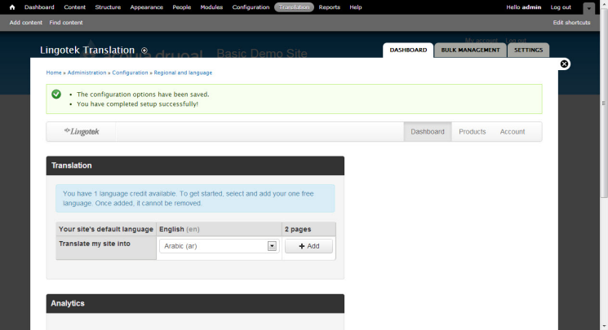
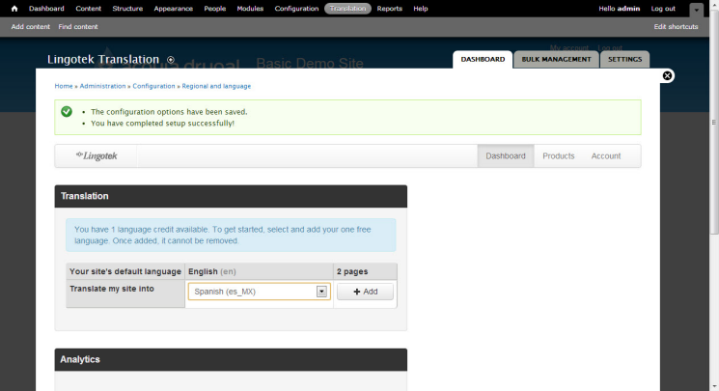
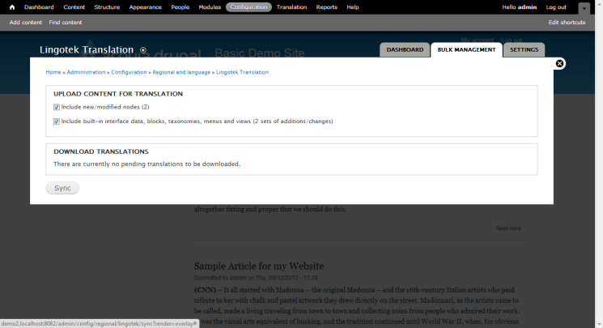
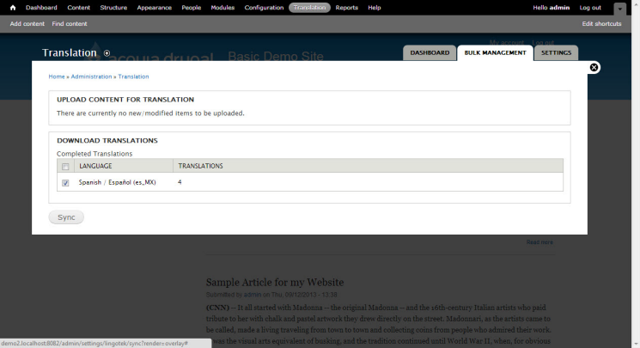
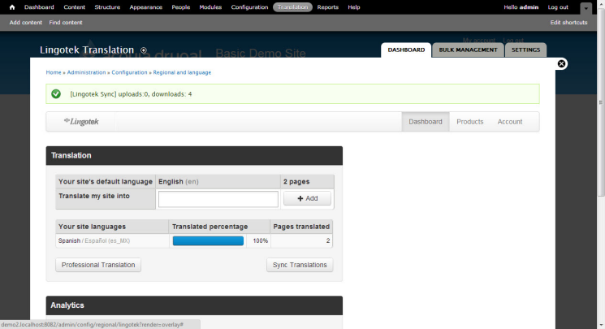
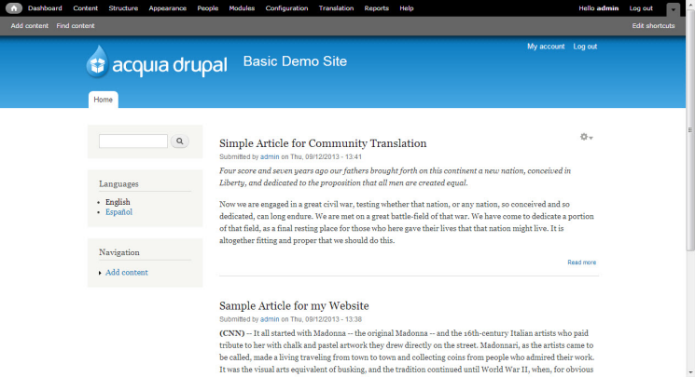
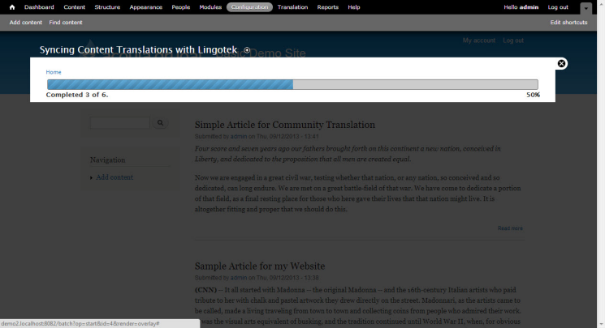
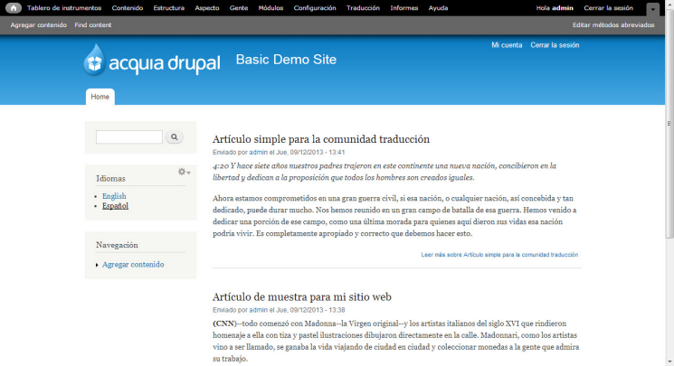
Setup and Initial Translation
Install
Configure
Machine Translate Site
Enjoy!

Slide 28
Internal Translation
English Content
Creating a new Article in English
Selecting Workflow
At the Node Level, you can pick different workflows for Translation
Using the TMS
Utilizing the TMS to Assign work to users
Users can easily find translations and Edit the Machine Translation.
Download Translation
Easily download the content to Lingotek

Slide 29
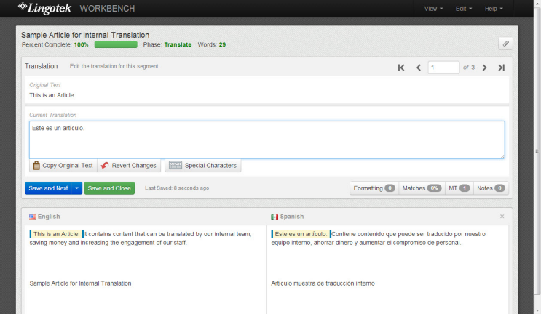
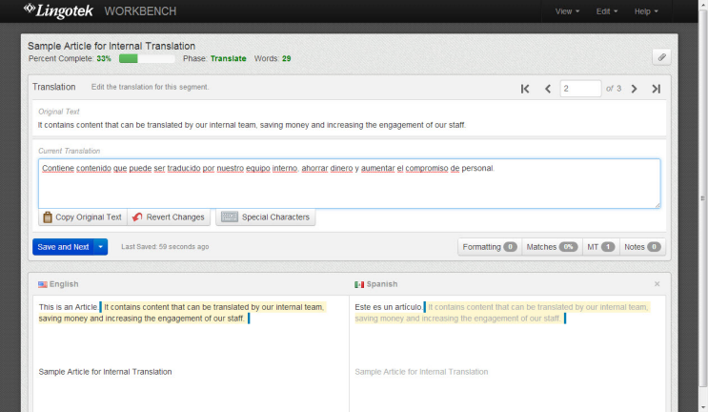
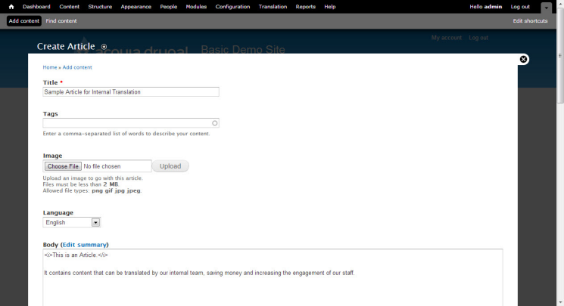
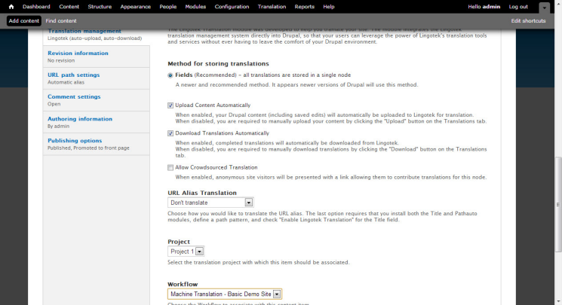
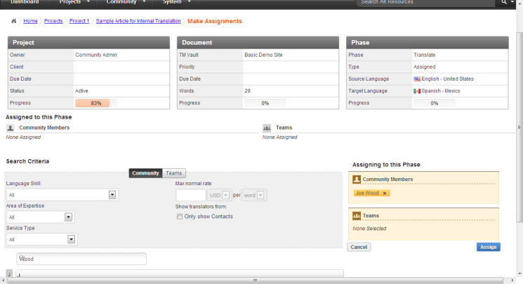
Internal Translation
Create Content
Selecting Workflow
Using TMS
D/L Translation

Slide 30
Professional Translation
Changing the Settings
Select the Professional Translation Profile.
Monitor Translation Progress
Utilize the Dashboard and Node Status to monitor the Translators Progress.
Translated Content Updated
New Updates can be immediately published or subject to internal review.

Slide 31
Professional Translation
Create a Node
Watching the Progress
Content Integration

Slide 32
Some Additional Workflows
Professional Translation + Internal Review/Edit
Have content professionally translated and then reviewed/edited by internal in-country personnel
Machine Translation + Internal Review/Edit
Machine translate new or changed content, then have internal/in-country personnel review/edit results. (Requires less time, especially if translation memories and glossaries are utilized.)
Machine Translation + Professional Review/Edit
Machine translate new or changed content, then have in-country professional agency review/edit results. (Costs less money, especially if translation memories and glossaries are utilized.)

Slide 33
Some Additional Workflows
Crowdsourced Translation + Internal Review/Edit
Have translations made by site visitors reviewed/edited internally prior to being published in production.
Crowdsourced Translation + Professional Review/Edit
Have translations made by site visitors reviewed/edited by professional linguists prior to being published in production.
Internal Translation (Corporate) + Internal Review/Edit (In-country)
Have new content translated internally at the corporate level and then reviewed/edited (further localized) by in-country individuals or teams prior to being published in production.

Slide 34
Lingotek Case Study
Notes:
Lingotek Case Study

Slide 35
Case Study
Challenge
With nearly 8 million customers in more than 180 countries, Alfresco was struggling manage its localized websites and keep it’s global marketing messages synchronized.
Notes:
With nearly 8 million people in more than 180 countries as customers, Alfresco needed a way to manage its localized websites and to synchronize its marketing messages in a simple, scalable and cost-effective solution.

Slide 36
Case Study
Solution
Alfresco used Lingotek – Inside Drupal with the Translation Management System to launch its global websites, sync content and get real-time statistics of where the translations were in the process.
Notes:
Alfresco used Lingotek – Inside Drupal with the Collaborative Translation Platform to launch its global websites, sync content and get real-time statistics of where the translations were in the process.

Slide 37
Customer Case Study
“Using Lingotek – Inside Drupal has been fantastic; the change in process for translation is huge. Emailing file attachments around seems so archaic.” Chris Vitti Director, Websites and Marketing Systems Alfresco
Notes:
“Using Lingotek – Inside Drupal has been fantastic; the change in process for translation is huge. Emailing file attachments around seems so archaic.” Chris Vitti Director, Websites and Marketing Systems Alfresco

Slide 38
Detailed Case Studies lingotek.com
Alfresco
Acquia
Intel
Cisco
SAIC
EMC
2
Notes:
Lingotek Case Study

Slide 39
Detailed Case Studies lingotek.com/drupal
Alfresco
Acquia
Intel
Cisco
SAIC
EMC
2
Notes:
Lingotek Case Study

Slide 40
Q & A
Bull Weber
Director of Sales
(Office) 203.647.0085
(Cell) 203.435.2548
(Email) bweber@lingotek.com
(Web) www.lingotek.com/drupal
Lingotek + Drupal:
The Power to Translate is Now Inside Drupal

Slide 41
Lingotek + Drupal:
The Power to Translate is Now Inside Drupal
Bull Weber
Director of Sales
Lingotek
Notes:
Introducing Lingotek THE TRANSLATION NETWORK

