Slide 1
Docker, Drupal and Persistence
Bill Juda

Slide 2
Who am I?
Bill Juda (wfj24@cornell.edu)
Drupal Developer for CIT Custom Development.
Started working with Drupal in 2013.

Slide 3
Agenda
Disclaimer
What is Drupal?
What is docker?
What is docker-compose?
My setup - let's look at code!
Demo - how does it work?
Documentation links.
Questions?

Slide 4
Disclaimer
Local development environments setup are usually based on personal preferences and knowledge.
I am not saying that this is the right setup for you.
This is just another option for you to look at.

Slide 5
What is Drupal?
You know what is it…
Or if you don’t it is a Content Management System.
Basically a sweet platform that makes sure developers don’t have to enter content!!

Slide 6
What is Docker?
Docker is a containerization system
What is a Container?
A Docker container image is a lightweight, standalone, executable package of software that includes everything needed to run an application: code, runtime, system tools, system libraries and settings. - Docker
Docker website for more information: https://www.docker.com/
For me it is a portable development environment that can be setup on Linux, Mac, or Windows with its configuration is stored entirely in code.

Slide 7
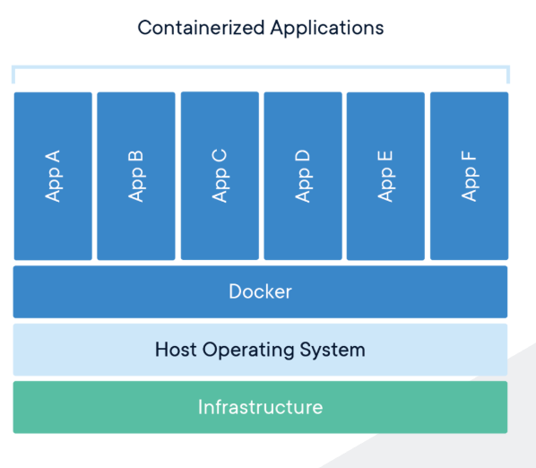
What is Docker continued.

Slide 8
Getting Docker
Get docker: https://www.docker.com/
Register for an account
Download and install docker

Slide 9
docker-compose
“Compose is a tool for defining and running multi-container Docker applications” - Docker Docs
For me it allows me to manage our local environment setup in code.
Documentation: https://docs.docker.com/compose/
docker-compose comes with your download of docker!

Slide 10
My setup
Custom docker image for a Ubuntu PHP/Apache2 web server.
Seperate project folder for each website I support.
Each project folder contains
A git repository to store the Drupal codebase.
Mysql directory to store the database files for persistence.
Restore directory to put back files in to restore environment.
Config directory to store some mysql specific config and apache config.
docker-compose.yaml

Slide 11
My custom Docker web server image.
The base image I build from is ubuntu:latest.
I install PHP, Apache2, mysql-client, and lots of supporting items.
This setup is based on my experience hosting various Drupal 7 and Drupal 8 instances.
Let's take a look...

Slide 12
My Dockerfile for building my Docker image
FROM ubuntu:latest
RUN apt update --fix-missing
# FIX TIMEZONE ISSUE
RUN apt install tzdata -y
# UTILS THAT ARE NEEDED
RUN apt install vim git zip wget curl -y
# STYLE TOOLS LESS AND COMPASS
RUN apt install npm -y && npm install -g less
RUN apt install ruby-compass -y && gem install sass-globbing
# APACHE2 NEEDED
RUN apt-get install apache2 -y && a2enmod rewrite ssl
# MYSQL CLIENT TO CONNECT BACK TO NETWORKED MYSQL CONTAINER
RUN apt-get install mysql-client -y

Slide 13
Dockerfile continued
# GET ALTERNATIVE PHP VERSIONS IF YOU DON'T WANT STANDARD
# RUN apt-get install -y software-properties-common apt-utils language-pack-en-base
# RUN LC_ALL=en_US.UTF-8 add-apt-repository ppa:ondrej/php
# RUN apt-get update -y
# PHP NEEDED - DEFAULT UBUNTU IS PHP7.2
RUN apt-get install -y php
RUN apt-get install -y php-common php-curl php-gd php-xml php-mysql php-mbstring php-zip php-ldap php-imagick
# PHP 5.6
# RUN apt-get install -y php5.6
# RUN apt-get install -y php5.6-common php5.6-curl php5.6-gd php5.6-xml php5.6-mysql php5.6-mbstring php5.6-zip php5.6-ldap php5.6-imagick
# PHP 7.1
# RUN apt-get install -y php7.1
# RUN apt-get install -y php7.1-common php7.1-curl php7.1-gd php7.1-xml php7.1-mysql php7.1-mbstring php7.1-zip php7.1-ldap php7.1-imagick

Slide 14
Dockerfile continued
# PHP APACHE2 HOOKUP STUFF
# SELECT CORRECT VERSION BASED ON PHP VERSION
RUN apt-get install -y libapache2-mod-php
# RUN apt-get install -y libapache2-mod-php5.6
# RUN apt-get install -y libapache2-mod-php7.1
# IF USING ALTERNATIVE PHP VERSION UPDATE BUT ALSO RESTART APACHE2
# SELECT CORRECT VERSION BASED ON PHP VERSION
RUN service apache2 restart
# RUN update-alternatives --set php /usr/bin/php5.6 && service apache2 restart
# RUN update-alternatives --set php /usr/bin/php7.1 && service apache2 restart

Slide 15
Dockerfile continued
# COMPOSER INSTALL
RUN php -r "copy('https://getcomposer.org/installer', 'composer-setup.php');" && php composer-setup.php && mv composer.phar /usr/local/bin/composer && php -r "unlink('composer-setup.php');"
# DRUPAL CONSOLE INSTALL
RUN curl https://drupalconsole.com/installer -L -o drupal.phar && chmod +x drupal.phar && mv drupal.phar /usr/local/bin/drupal
# DRUSH INSTALL
RUN composer global require drush/drush:8.x-dev --prefer-source && ln -s /root/.composer/vendor/drush/drush/drush /usr/local/bin
# RUN composer global require drush/drush:9.x-dev --prefer-source && ln -s /root/.composer/vendor/drush/drush/drush /usr/local/bin
# UPDATE AND CLEANUP
# RUN apt-get dist-upgrade -y && apt-get autoremove -y
CMD ["/usr/sbin/apache2ctl", "-D", "FOREGROUND"]

Slide 16
My docker-compose.yaml
This contains:
The configuration of my mysql database container and my webserver container.
The mapping of directories based on my program folder to allow for persistence of my Drupal environments.
The networking of these two containers.
Let’s take a look...

Slide 17
Code - docker-compose.yaml
version: '3.5'
services:
db:
container_name: db
image: mysql:5
ports:
- "3307:3306"
environment:
MYSQL_ROOT_PASSWORD: DRUPALCAMP
MYSQL_DATABASE: drupal
volumes:
- ./mysql:/var/lib/mysql
- ./conf/my-custom.cnf:/etc/mysql/conf.d/my-custom.cnf
tty: true
restart: always
networks:
- overlay

Slide 18
Continued - docker-compose.yaml
web:
container_name: webserver
image: web_web:latest
volumes:
- ./app:/var/www
- ./conf/apache-drupal.conf:/etc/apache2/sites-enabled/000-default.conf
- ./restore:/restore
- ./conf/my-custom.cnf:/etc/mysql/conf.d/my-custom.cnf
ports:
- 80:80
- 443:443
tty: true
depends_on:
- db
restart: always
networks:
- overlay
networks:
overlay:
name: network

Slide 19
Common docker-compose and docker command
docker-compose build
Build a docker image from a docker compose file.
docker-compose up -d
Create a docker env from docker files and detach so you are not stuck in your terminal.
docker ps -a
Show me all docker containers.
docker exec -it [container_name or container_id] bash
Get into a docker container in a bash prompt
docker stop $(docker ps -qa)
Stop all docker container
docker rm $(docker ps -qa)
Delete all docker container

Slide 20
DEMO!!!

Slide 21
Helpful Links
Docker: https://www.docker.com/
Docker Docs: https://docs.docker.com/
Docker Compose: https://docs.docker.com/compose/
My setup for you: https://github.com/judaw/docker-stuff

Slide 22
Questions?
wfj24@cornell.edu

