Slide 1
The Journey of Ithaca College
into Drupal 8
Joel Travieso
Four Kitchens
drupal: jts86
Eric Woods
Ithaca College twitter/drupal: woodseowl
Notes:
Hi, I am Eric, this is Joel, and we are part of a team that has been working a new website for Ithaca College

Slide 2
Team & Partners
Molly Israel, management
David Cameron, product
Katherine Malcuria, design
Eric Woods, development
Brian Bessire, strategic
Nellie Wallace, content
IC Leadership
...many others: www.ithaca.edu/crc/blogs/work_in_progress/meet_the_team/
Joel Travieso, lead
Brian Lewis, front end
Brandy Jackson, project
Notes:
There's a good size team including a core group at Ithaca College, key talent from Four Kitchens who have expertly guide us into the world of Drupal, and beyond, a design agency that helped lead our product development and ground our work in research-based decisions.
Many others have been involved and we now have a blog documenting some of our work

Slide 3
Transforming ithaca.edu
Notes:
This project is a complete reimagining of not just our website design and content but our content management system, the infrastructure beneath it, and the process to support it.

Slide 4
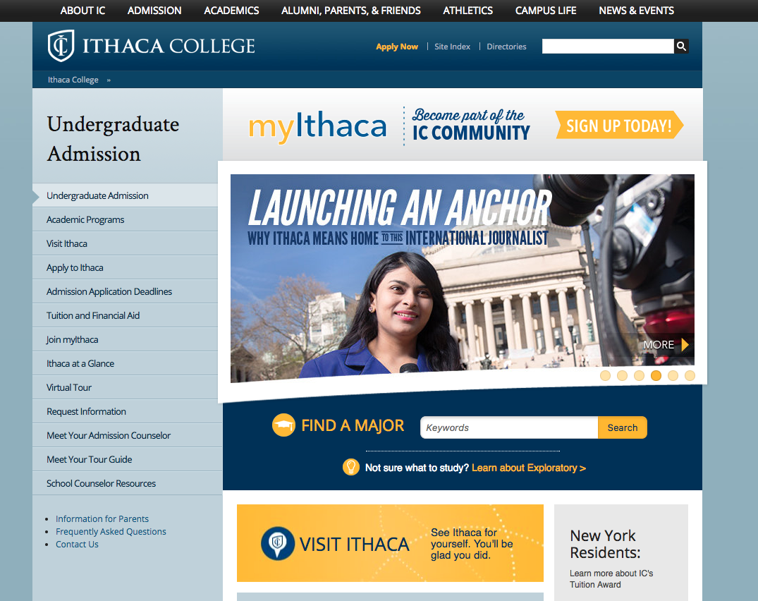
The Problems
Outdated and bloated content
Problematic information architecture
Out of maintenance CMS
Custom-built, self-hosted infrastructure
No process for evolving web presence
No product champion for web
Notes:
So this is what we were looking, what we are still looking at.

Slide 5
The Process
Strategic investment from leadership
Research and discovery to understand requirements
Partnering with experts
Build foundations
Learn and grow
Research and discovery to guide implementation
Iterative design and build
Release and iterate
Notes:
We wouldn't get to do a project like this if it weren’t for the investment from leadership, both in dollars and commitment to the team. And we wouldn't succeed in the long term without a relentless focus on quality. That means doing our homework to guide our decision-making. That means working with experts that don’t just build our website with us, but transform the ways that we do it. That means using an iterative process to that we are always learning and improving.
And I want to acknowledge that this was a rare opportunity and it’s a privilege to work on a project of this nature.

Slide 6
People > Process > Tools
Notes:
One of those privileges is the people that you get to work with.
Good people make it easy to have good process.
And good process is always more important than the tools

Slide 7
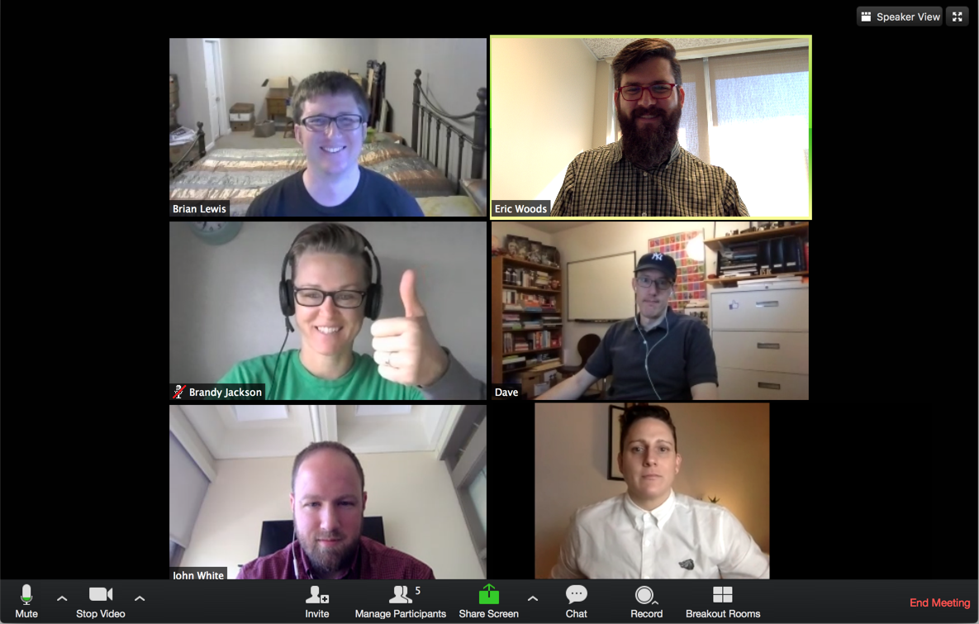
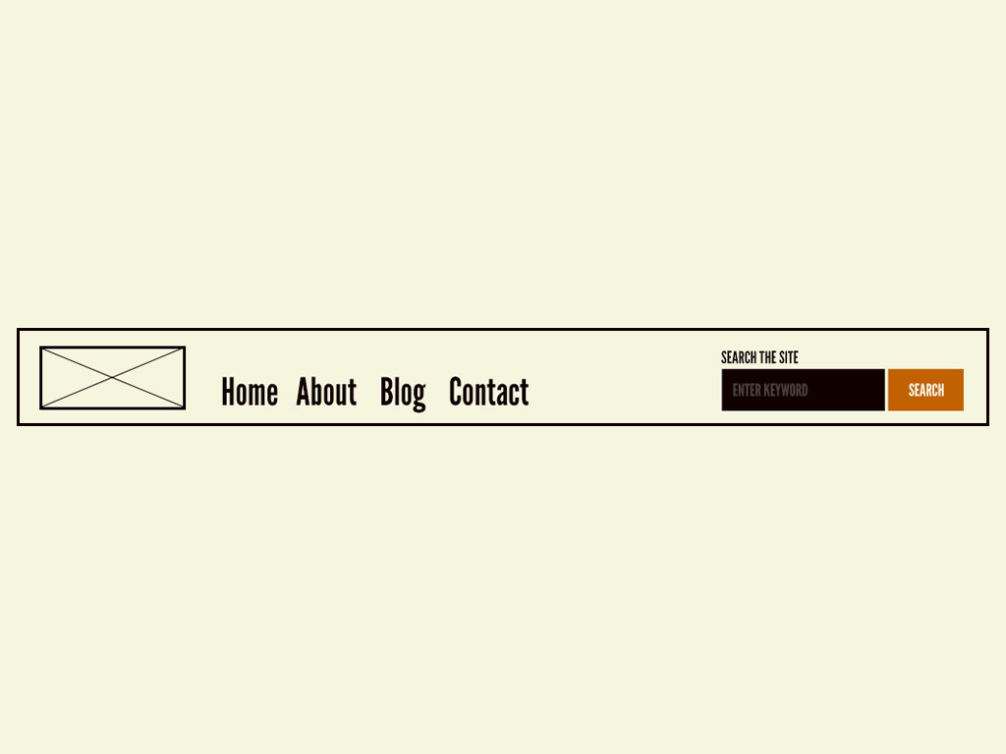
People
Development
3 - 4 Developers
1 - 2 Designers
Product owner
Scrum master

Slide 8
Process: Agile / Scrum
Simple
Light on formalism
Lots of convention
Principled
Rules
Etiquette
Communication
Routine
Daily standup
Bi-weekly sprint
planning
Retrospectives
Release Mondays

Slide 9
Tools
Communication
Zoom
Slack
Trello
Jira
Zeplin + Sketch
Distributed
Automation
GitHub + PRs
CircleCI
Pantheon + Terminus
Local Dev
Docker + Drush
Node
(PhpStorm)
Jira Stories become GitHub branches / PRs, stories grouped in weekly releases

Slide 10
Automation

Slide 11
GitHub Workflow
STORY
release
S
STORY
2
release
1
subtask 1
subtask 2
subtask 3
3
Notes:
Each story generates a PR pointed to the release branch
Sometimes, we need to break Stories into subtasks to speed up development (so multiple devs can work simultaneously)
If the Story has subtasks, then each subtask generates a branch, the first one being the base for every other
Briefly describe other useful practices listed

Slide 12
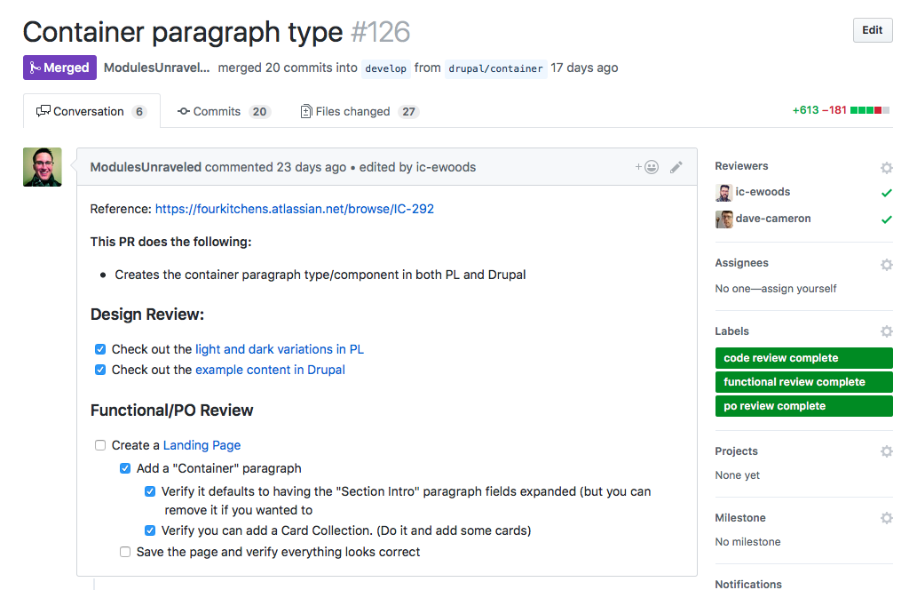
GitHub Workflow
Some useful practices
1-1 correlation with tickets
Clear descriptions
Documented review steps
Discussion threads
Status labels
Require approved review and CircleCI pass to merge
Fully linked to tickets, test site, documentation, etc.
Notes:
Each story generates a PR pointed to the release branch
Sometimes, we need to break Stories into subtasks to speed up development (so multiple devs can work simultaneously)
If the Story has subtasks, then each subtask generates a branch, the first one being the base for every other
Briefly describe other useful practices listed

Slide 13
Continuous Integration Scheme
FEATURE BRANCHES
MULTIDEVS
DEV
RELEASE BRANCH
TEST
MASTER BRANCH
PROD
Notes:
Describe how each event in github triggers an action in Pantheon
Describe circle.yml file

Slide 14
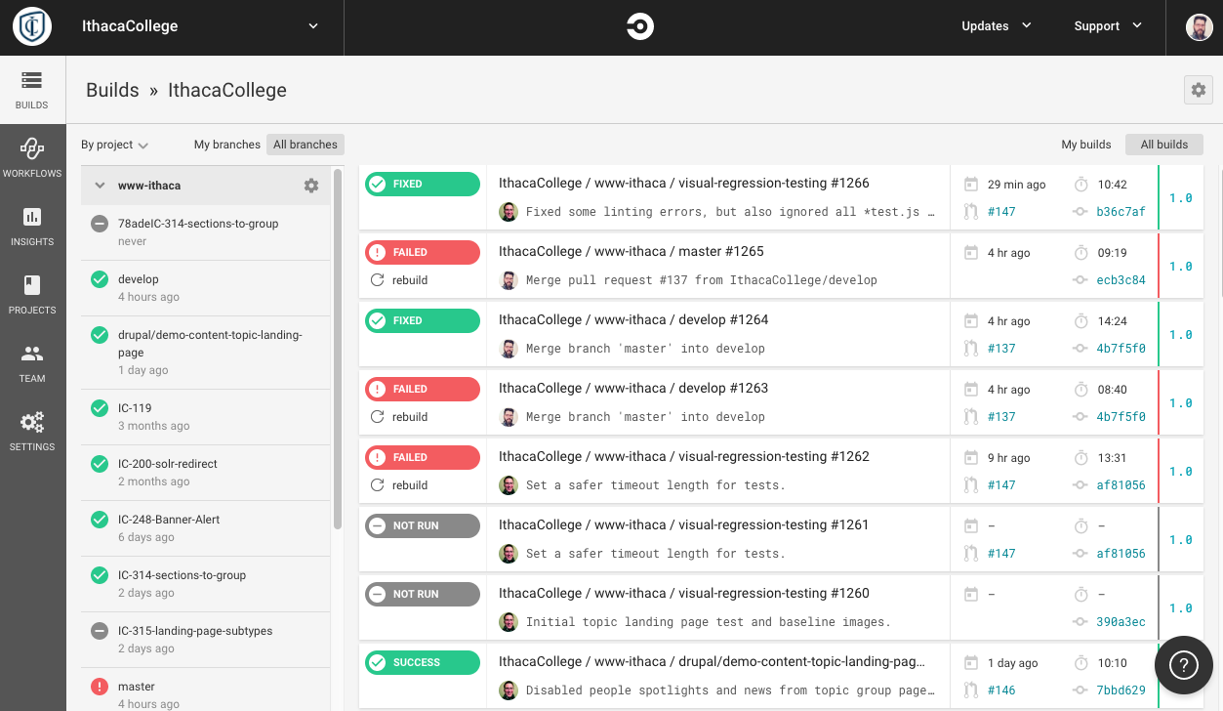
Code flow
Commit on...
MASTER
RELEASE
FEATURE
MULTIDEVS
DEV
TEST
PROD
Notes:
After reviewing circle.yml, wrap up with brief outline of the flow of the code depending on where it is committed to

Slide 15
Other tools
Composer for dependency management
Terminus for remote interaction with Pantheon
PHP CodeSniffer and ESLint for PHP/JS linting
Behat for testing
Local environment setups and documentation for Docker / local host
Notes:
Composer: no need to deal with libraries or contrib modules

Slide 16
Bounded Versatility
Notes:
The work on automation has been invaluable for us in our development and deployment pipeline. Joel's work along with the resources that he can tap at Four Kitchens, and the amazing tools and companies that support automation and continuous integration let us develop with great confidence. So now we’ll talk about how we build upon that foundation of infrastructure.
I'm a take you on a brief journey of how we got to this term: bounded versatility.

Slide 17
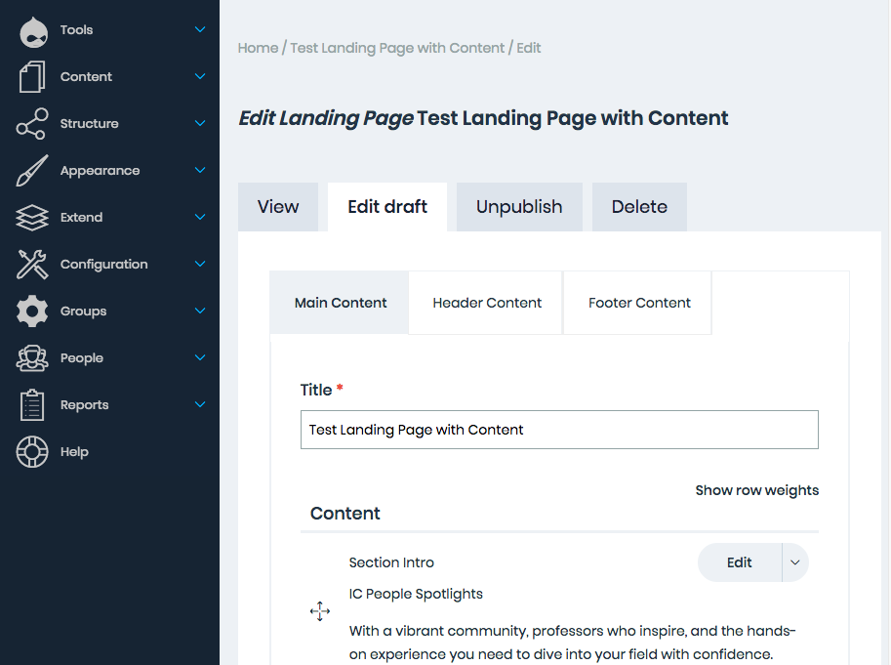
Two Products
Website
Content Management
Notes:
Something that has come up for our team time and again is that we are actually working on two products
website for Ithaca College
system for building a website for Ithaca College
Even though our planning and design of artifacts focused on that front end, of course we were looking at how would we actually build these systems.
I think that is a really challenging thing about a big web project like this. We have to build these robust systems for many more possibilities then we have imagined

Slide 18
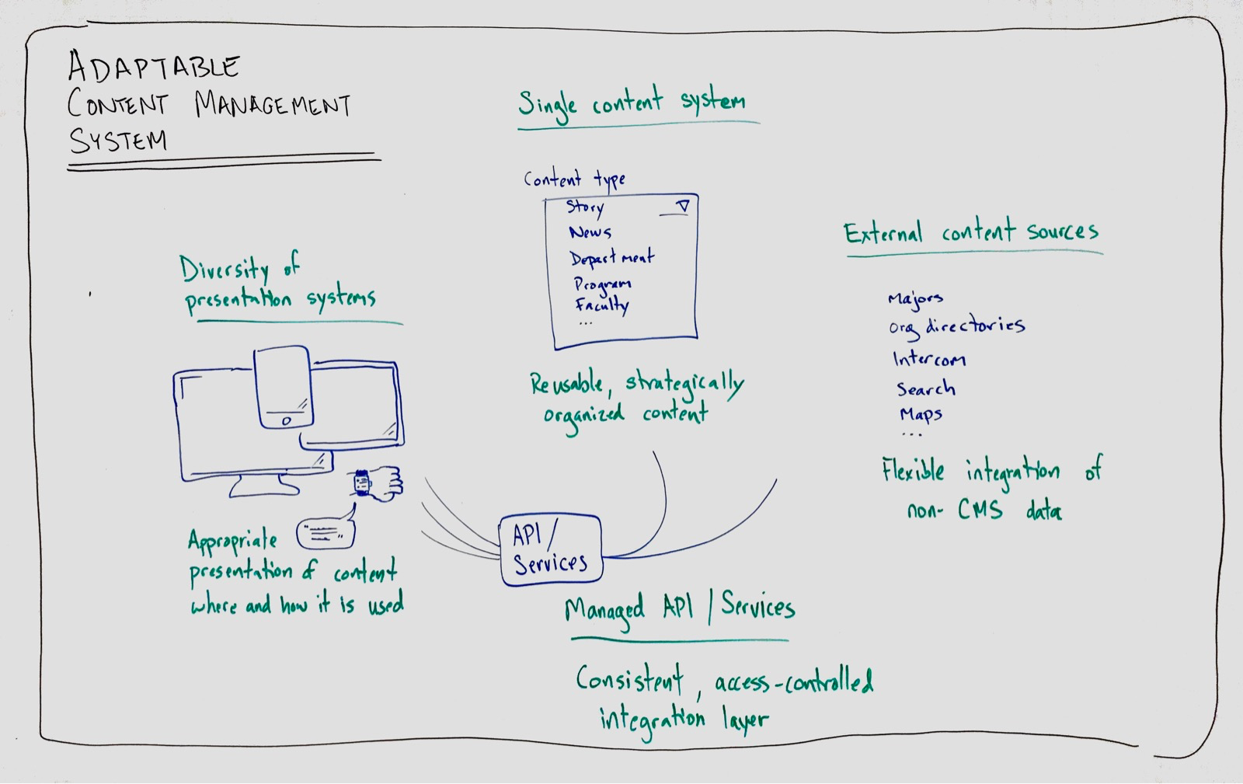
Adaptivity
Notes:
That expanse of possibilities has emerged from our world of iPhones and smart watches, digital signage and giant screen TVs, is that we often don't know how our content will get presented.
I feel fortunate to get to do this project in the era of web development we are in. The diversity of ways that our content will be presented has allowed of maturing of thought toward a more inclusive approach to supporting users. Our systems have to be fundamentally adaptable.

Slide 19
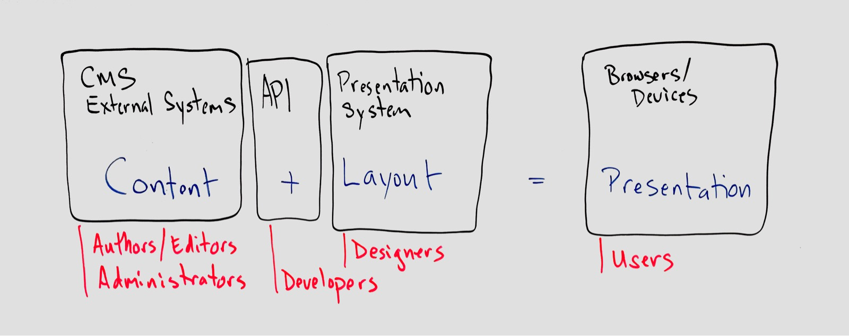
Emergence of Systems
Design System
Atomic Design, Pattern Lab
Presentation System
Emulsify, Twig
Content System
Paragraphs Module
Notes:
If you want something to be adaptable, it generally means you need systems. You can't plan for every possibility, every combination. You need to build from smaller units that have limited variation.
Early on in our process and we saw this in these layers utilized by people in different roles that would get used to create the website product.
And digging through how to separate those layers we ended up with things that are design system level, things at a presentation system level, and things at a content system level. These are familiar parts to many of you, but it helps to name them. And within each of those areas we want to provide flexibility within constraints: bounded versatility.

Slide 20
Content Components
COPE
Create Once Publish Everywhere
Semantic Content Management
Fields
Paragraphs
Content Types

Slide 21
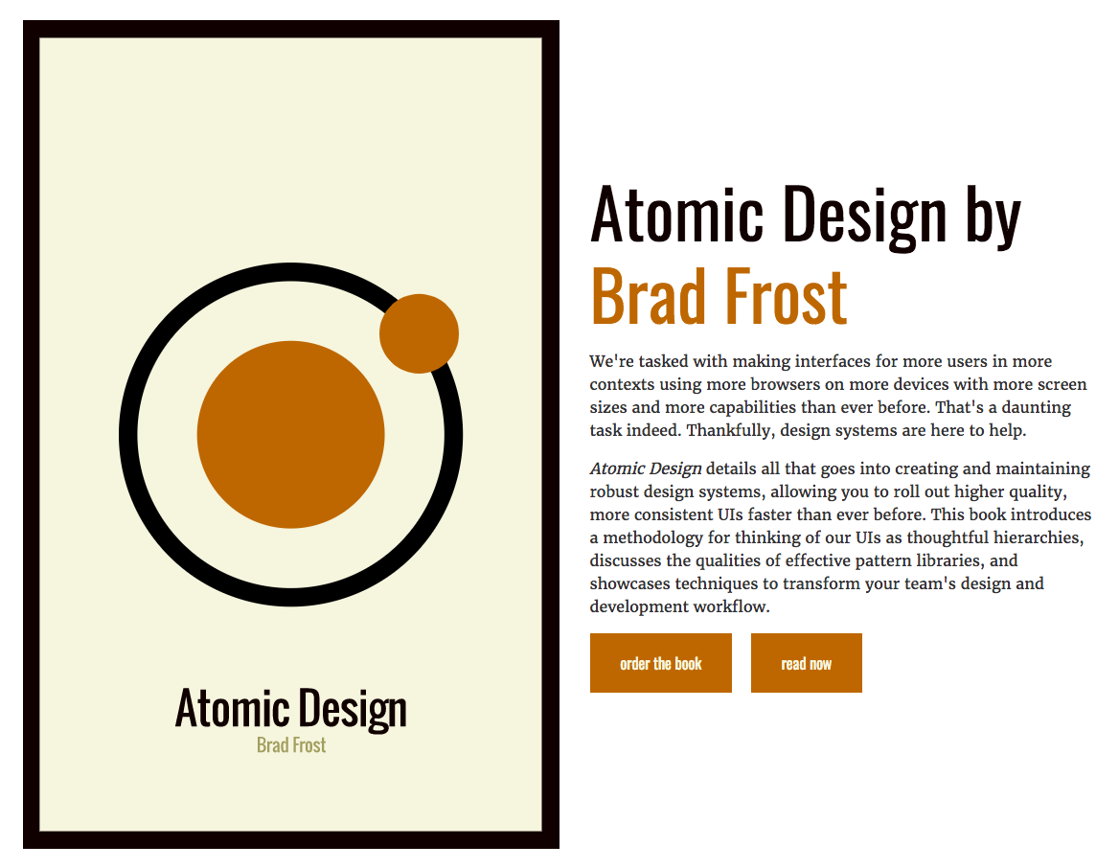
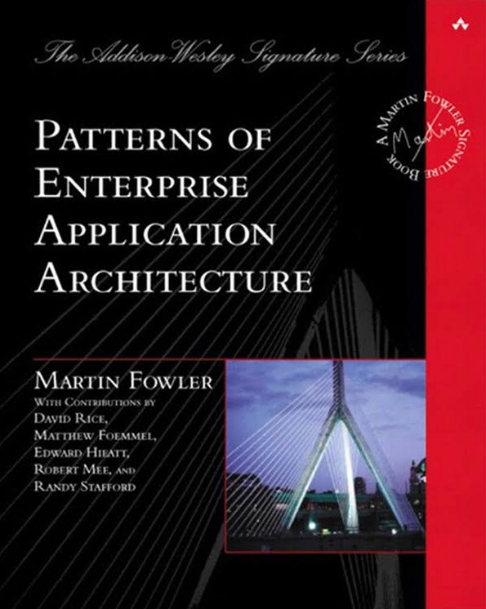
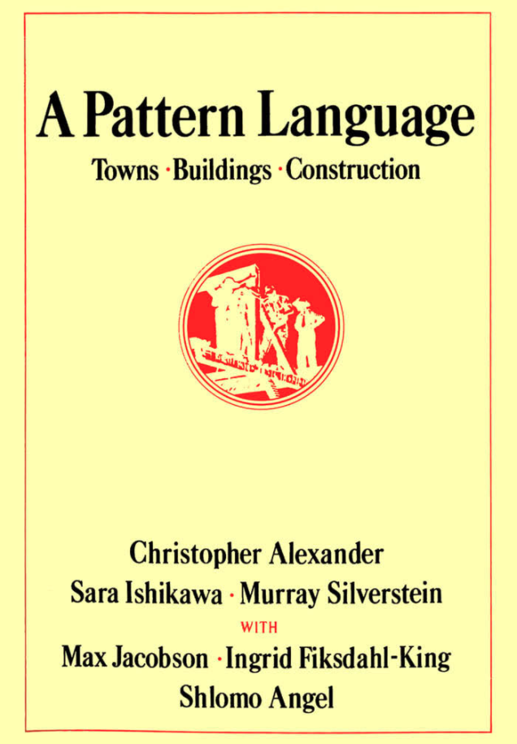
Design System
“As the craft of Web design continues to evolve, we’re recognizing the need to develop thoughtful design systems, rather than creating simple collections of web pages.”
Atomic Design
A systematized approach to developing website pattern languages
Know your
roots:
Read http://atomicdesign.bradfrost.com/
Notes:
How many of you are already familiar with atomic design? And keep your hands up if you have worked on implementing a design system that uses that approach.
Even if you have no experience with atomic design, have not even heard the term, you already think this way. Our brains are wired for patterns. So you already recognize and work with them: Buttons, headings, a footer, a caption. And if you're working on the presentation layer of building a website you already strive to make those consistent patterns.
An interesting thing about patterns and pattern languages is that the primary work comes in identifying them, in naming them, defining them. We often innately recognize them, but what I recognize as a pattern and what you recognize as a pattern may not be the same, and so we have this conversation and we start to build a language so that we can communicate effectively and design and build efficiently.
As an aside I want to point out that the idea of pattern languages has deep roots. Developers have been talking about design patterns in programming for about 20 years. And a generation before that was a seminal work in architecture called A Pattern Language by Christopher Alexander. We stand on the shoulders of giants.

Slide 22
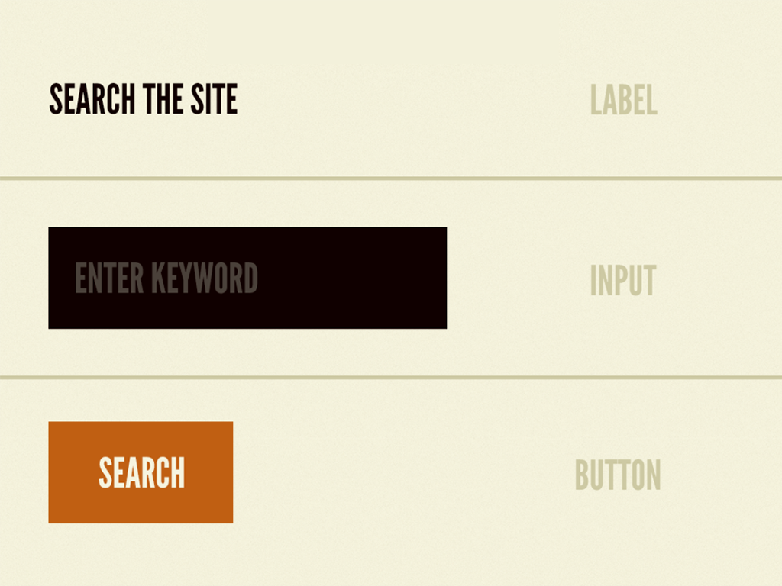
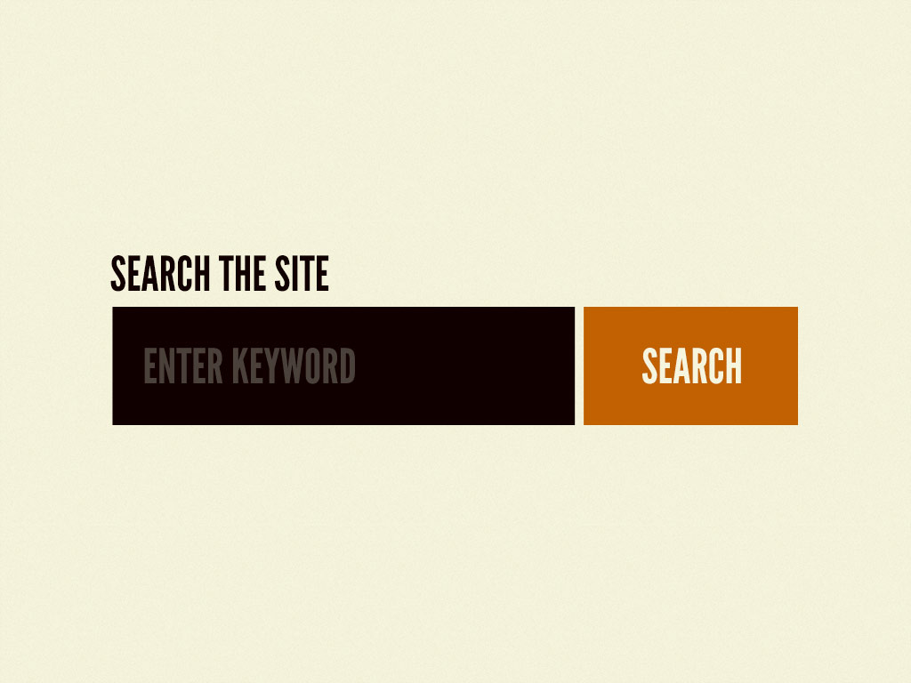
Atomic design
Atoms > Molecules
Organisms
Notes:
So here's the simple example from Brad Frost’s book. He uses this nomenclature of atoms, molecules, and organisms to build templates and pages.
You can see here we’ve got these atomic pieces: a label, an input, a button. They get combined into molecule, perhaps we’ll call it the search box. And that search box is bonded together: it's a concept that requires all those items to be a thing that is usable. We can then combine that search box with other molecules that together make up this organism we could call a header.

Slide 23
Patterns with People
Workflow
Gather the right people
Find and share patterns
Build things
Iterate
Tools
Sketch + Zeplin
Pattern Lab / Emulsify
Twig
Paragraphs module
Notes:
So I mentioned how a pattern language is something that you develop for communication. It's messy work. You have to talk a lot and point at things. And sometimes it can seem like you are debating minutia like: should that be a "card" or a "call out"? But those are critical conversations that fundamentally shape what you build and how everybody interacts with it. These concepts become the pieces, the building blocks.
And you don't get them right. You have to iterate, have to try them out, put them into practice and see if the ideas work.

Slide 24
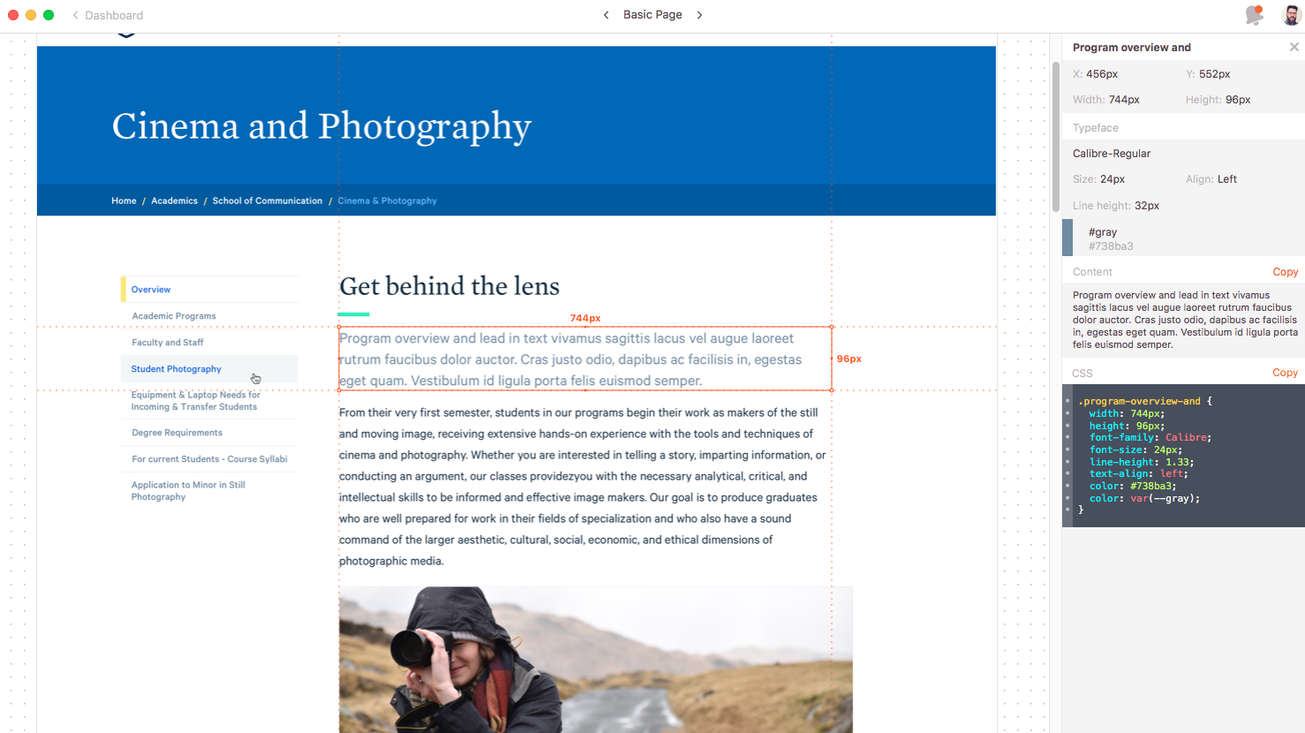
A Pattern Development: Design
Notes:
This is a design of what we call our basic page. When we first got this design, what I have highlighted was a piece that was clearly different from the body text or the heading above it.
(By the way this is a screenshot from a tool called Zeplin which integrates with Sketch. It is super handy for passing information from design to development; particularly things like typeface and size, colors, and positioning. The desktop application has a super useful feature where you can overlay the design onto another screen and see whether your code version matches the design version.)
Pattern questions that came up were things like: Will this highlighted text always be next to the heading? Is it a required piece of content on every page? If not, does the line go with the heading or does it go with the text below it? Will that style be used for any other part of the site? What do we call it?

Slide 25
Tools: Pattern Lab
View atomic design components
See components interact
Test responsiveness of design
Easily iterate on designs
http://patternlab.io
“Pattern Lab helps you build thoughtful, pattern-
driven user interfaces using atomic design principles.”

Slide 26
A Pattern Development: Patterns
Molecule
Atom

Slide 27
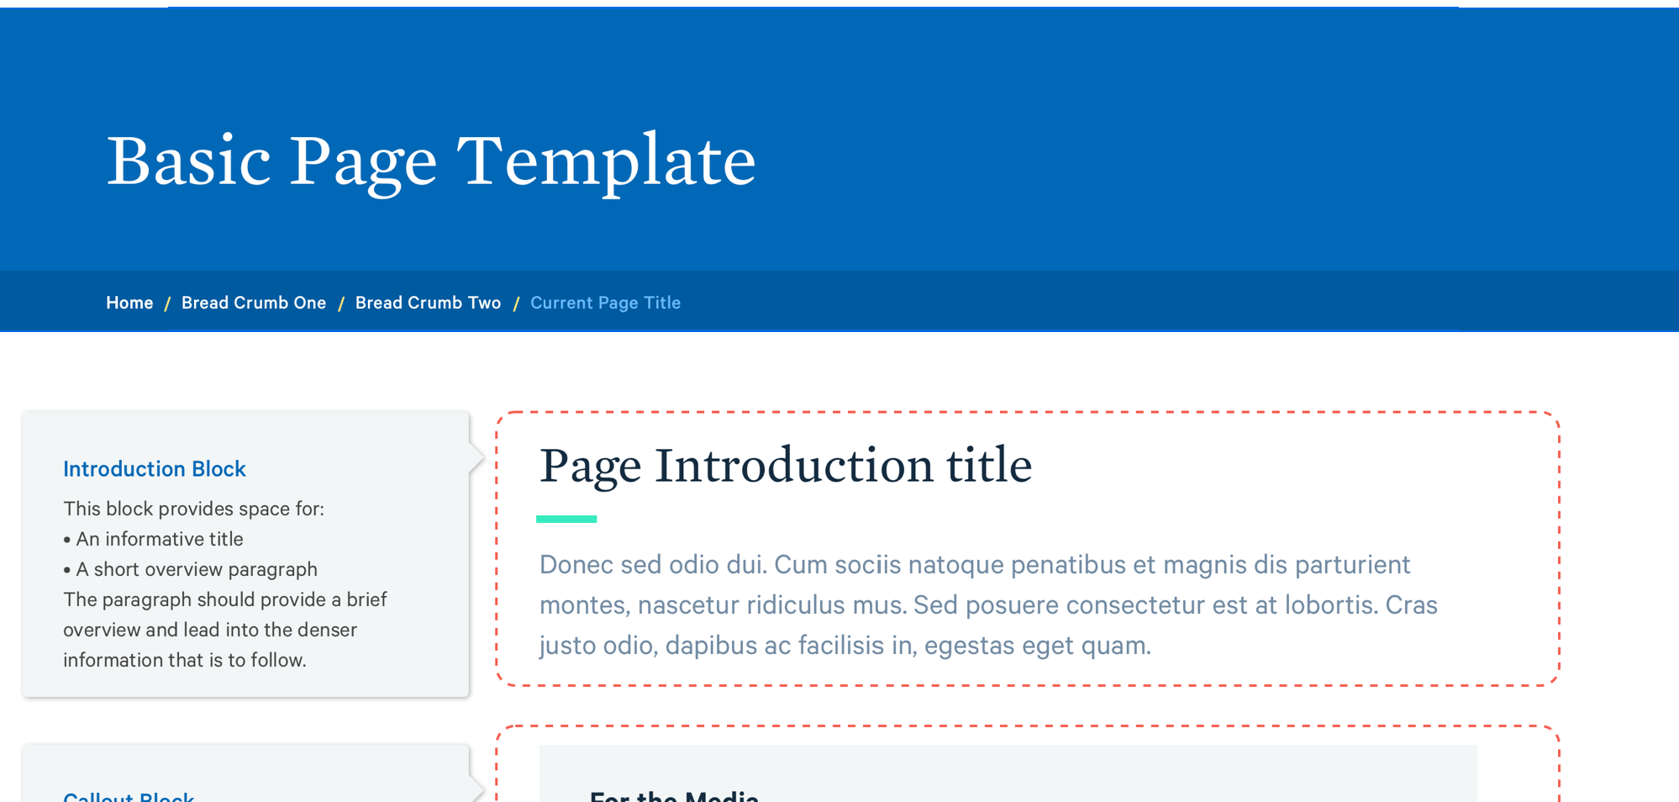
A Pattern Development: Patterns

Slide 28
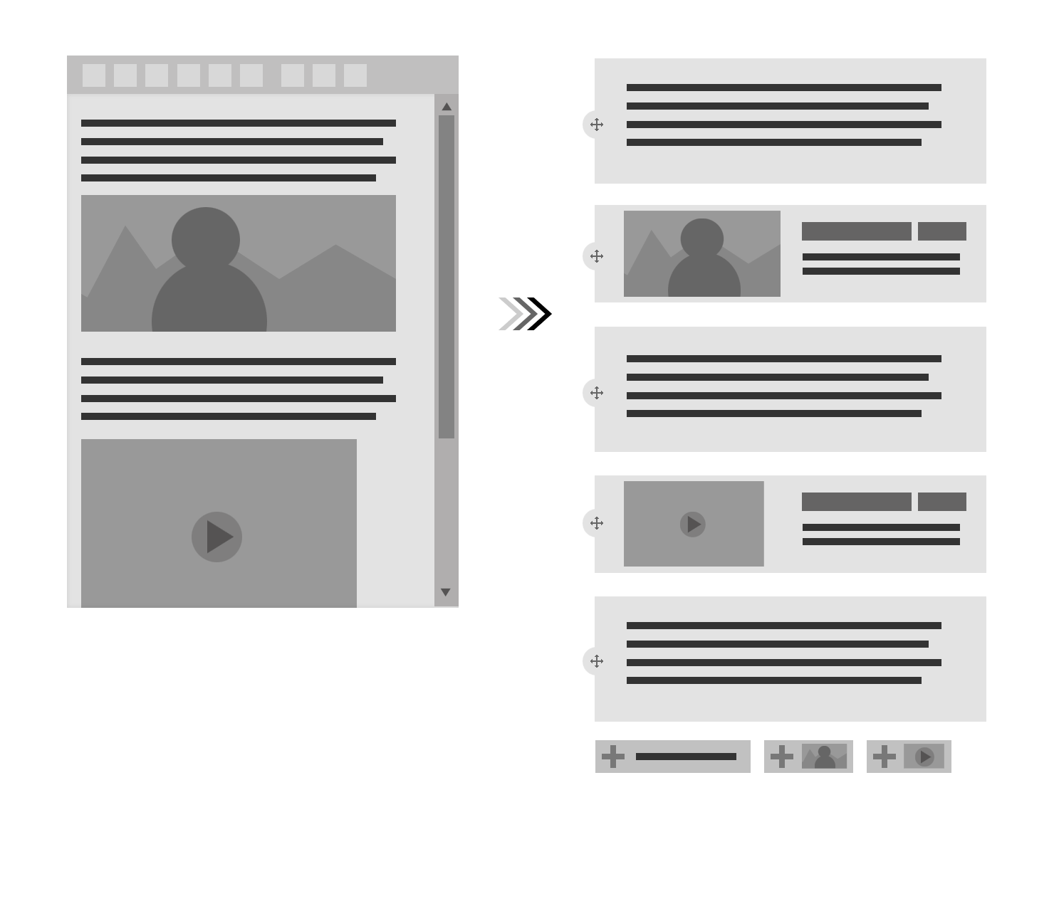
Tools: Paragraphs Module
Componentize content types
https://www.drupal.org/project/paragraphs

Slide 29
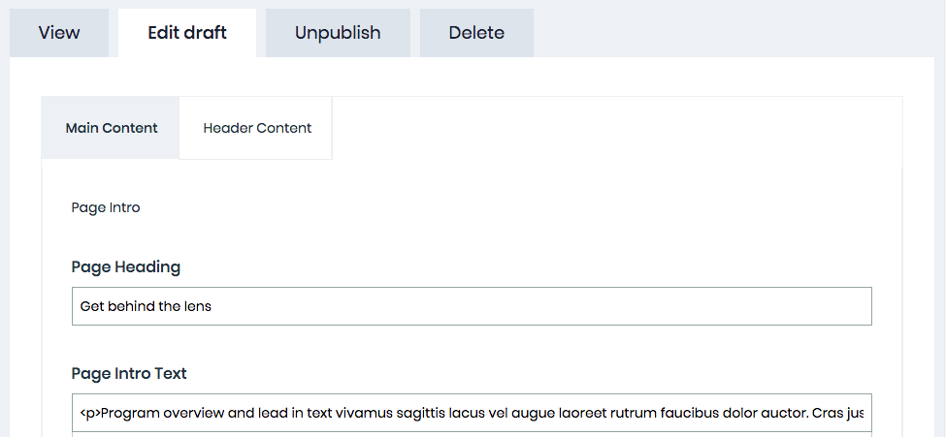
A Pattern Development: Paragraphs
Content
type
Paragraph
type

Slide 30
Tools: Emulsify
Theme starter kit
Simple:`npm start`
Fast: Browser sync
http://github.com/fourkitchens/emulsify
“Component-driven prototyping tool using Pattern Lab v2 automated via Gulp/NPM. Also serves as a starterkit Drupal 8 theme.”

Slide 31
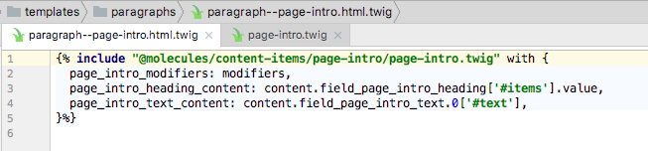
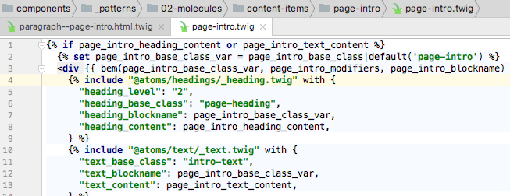
A Pattern Development: Twig + Emulsify
Drupal Template
Emulsify Pattern

Slide 32
Patterns over Time
Living style guide
Refactoring to patterns
Refinement

Slide 33
Governance
Notes:
Process … infrastructure and automation … designs and patterns for content on pages …
But the content itself needs structure. And this where governance enters.

Slide 34
Federated Governance
Sections (ithaca.edu/xxx)
Topics (ithaca.edu/xxx/xxx/xxx)
Academics
Resources
About
About Section
About Site
Diversity Site
Sites (ithaca.edu/xxx/xxx)
Visit Topic
Action Items Topic
Academics
Resources
About
History Topic
Campus Climate Survey Topic
etc.
etc.
Business School Site
Human Resources Site
About Site
Pages (ithaca.edu/xxx/xxx/xxx/xxx)
Park School Site
Housing Site
Diversity Site
Music School Site
Health & Wellness Site
People Site
About Site
HSHP School Site
Library Site
History Topic
H&S School Site
Finance Site
Years of Challenge Page
On The Move Page
Extended Study Site
Fitness Center Site
etc.
etc.
etc.
Notes:
Audience-focused site hierarchy
Strategic content management (professional communication staff)
Distributed content management (300 cms users)

Slide 35
Scenario
SECTION
Each level has:
Members
Roles
Content
SITE
TOPIC
PAGE
SUBPAGE
www.ithaca.com/section/site/topic/page/subpage
Notes:
Describe technical necessities regarding governance

Slide 36
The group module
Close to a full release for Drupal 8, while Organic Groups not yet stable
A group, as a custom entity:
Contain other entities (including other groups)
Has members
Has internal permissions
Has internal roles
Can be of a particular Group type and have particular properties
https://www.drupal.org/project/group
Notes:
AFTER: Jump into an overview of the group module: create a group, check the related entities, roles, permissions, etc

Slide 37
Site Hierarchy
PARAGRAPH TYPES
SECTION (GROUP TYPE)
Section Content
SECTION LP (CONTENT TYPE)
SITE (GROUP TYPE)
Section Content
SITE LP (CONTENT TYPE)
TOPIC (GROUP TYPE)
Section Content
TOPIC LP (CONTENT TYPE)
PAGE (CONTENT TYPE)
SUBPAGE (CONTENT TYPE)
Notes:
Each group contains the next one
Each group contains other content
Each group references a node that’s rendered when the group is accessed
Each group type references a node of a different type, determining the flexibility of the components usable

Slide 38
Legacy Content

Slide 39
Content Migration
HOLDING SITE
LEGACY
WWW
Moderation
Migration Manager performs migration Legacy - Holding of Topic X
Migration Manager assigns Topic Manager role for Topic X
Topic X Manager names other Topic X Members
Topic X Members perform content moderation on Topic X
Topic X Manager informs Migration Manager that Topic X is ready
Migration Manager performs migration Holding - Production of Topic X
Notes:
Describe the need
A 1-1 mapping is not possible: there are structural changes rather than improvements: migration is partially manual
Why we need a holding site: moderation without danger or pollution in production
Profiles similar to Topics: we bring the subtrees and convert to Topics
Describe moderation workflow

Slide 40
Indexing legacy content
CSV FILE
LEGACY
CRAWLER
MIGRATION
WWW
33K
LEGACY CONTENT
Title
Body
URL
Notes:
Describe the need
Crawler returns a CSV
We migrate the CSV
Create Legacy Content nodes
Index Legacy content nodes

Slide 41
Redirecting to legacy
LEGACY CONTENT
Title
Body
URL
LEGACY
Redirect to original content page
Notes:
Describe how we hide legacy content nodes and redirect to the original content page in legacy

Slide 42
Future

Slide 43
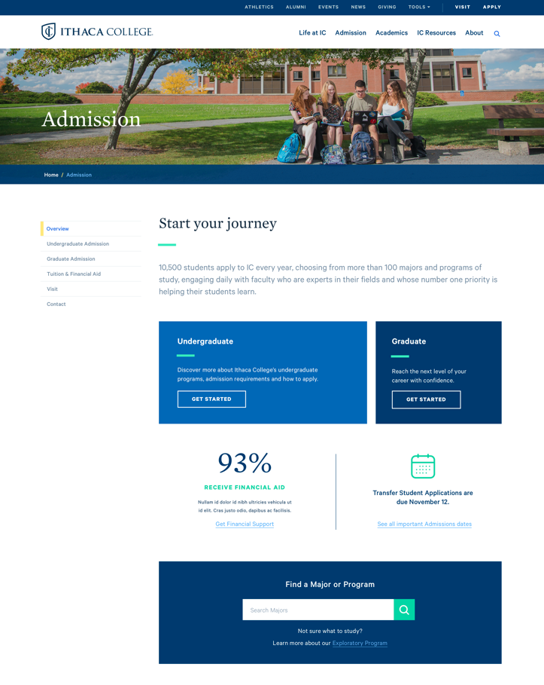
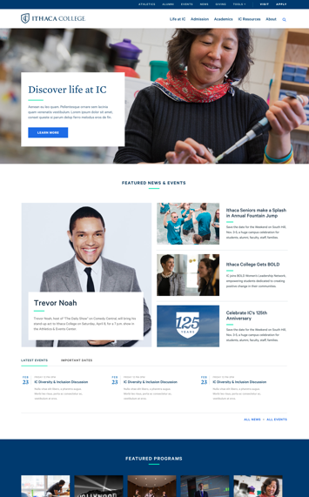
Release, Review, Revise, Repeat
Internal Test
Now
MVP Launch
Winter
Migrations
2018
https://www.ithaca.edu/crc/blogs/work_in_progress

Slide 44
Thank you!
Joel Travieso
Four Kitchens
drupal: jts86
Eric Woods
Ithaca College twitter/drupal: woodseowl
https://www.ithaca.edu/crc/blogs/work_in_progress

Slide 45
Title
Heading
Text

