Slide 1
Challenges and Successes Implementing a College Website
Building a Large-Scale Website in a Single Drupal Instance
Gang Wang
Web Development Professional
CIT, State University of New York Geneseo

Slide 2
Topics
1. Website design decisions
2. Infrastructure
3. Why choose Drupal
4. Making website appear integrated and consistent
5. Drupal Theme & Template Design

Slide 3
Topics
6. What third-party modules did we utilize?
7 Should we customize or hack the Drupal core?
8. Building custom modules to fill gaps
9. Successes
10. Challenges

Slide 4
1. Website design decisions
Chief Purpose
So many websites with different looks
Make all websites looked like one Geneseo website
Outsource And Do It Ourselves
Outsource for website design & graphic design
DIY: Drupal design and implementation
Optimize Site Navigation System
Attractive ‘Look and Feel’
CMS for Easy to Use
CMS for Easy to Maintain

Slide 5
2. Infrastructure
Geneseo Website
Main Site
Sub sites
Departments, Offices etc.
Drupal 6
Linux Apache Mysql PHP
Loading Balance (www1, www2, www3)
LDAP Authentication
Sub Sites Permission and Access Control

Slide 6
3. Why choose Drupal?
CMS that is easy to Use and Maintain
Site that is flexible enough to evolve in any direction
Site that can easily be configured to interact with other sites or with other technologies
Site that can easily handle complex forms and workflows
Ability to create our own content types
Ability to quickly organize and display lists of information
Quickly develop custom functionality

Slide 7
Drupal Project Progress
Research & Outsource
Design & Implementation
Build Sites
Migration
Build Modules
Website Infrastructure
Drupal Theme Design
Drupal Templates
Web Technology: HTML, CSS, JavaScript
Build applications to migrate
Migrate data from Oracle to Mysql
Sub sites cut over
Fixed all links
Test on testing server
Drupal Training To Editors
Drupal installation, setup & configuration
Drupal web server / VM
Mysql database
Contributed modules
Build modules
Improvement
Enhancement
New layouts & templates
New features
Do research for top CMS systems
Outsource for Website Design and
Graphic Design

Slide 8
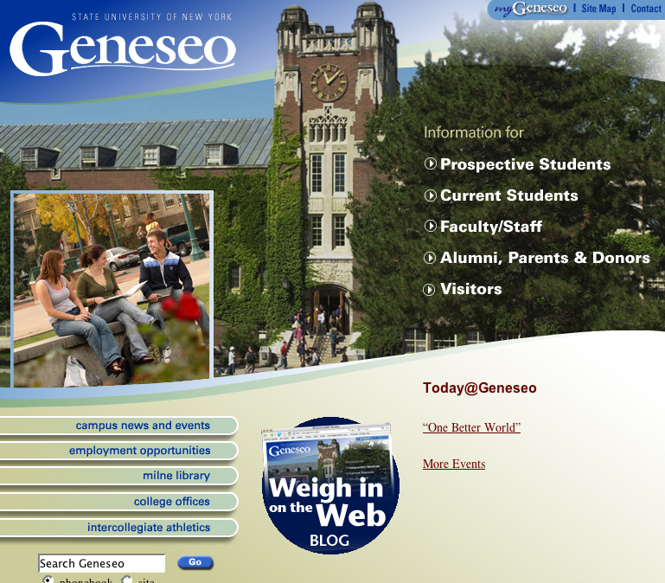
4. Integrated & consistent
So many websites with different looks
Dreamwaver V.S. CMS

Slide 9
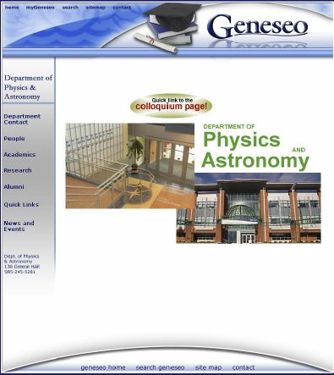
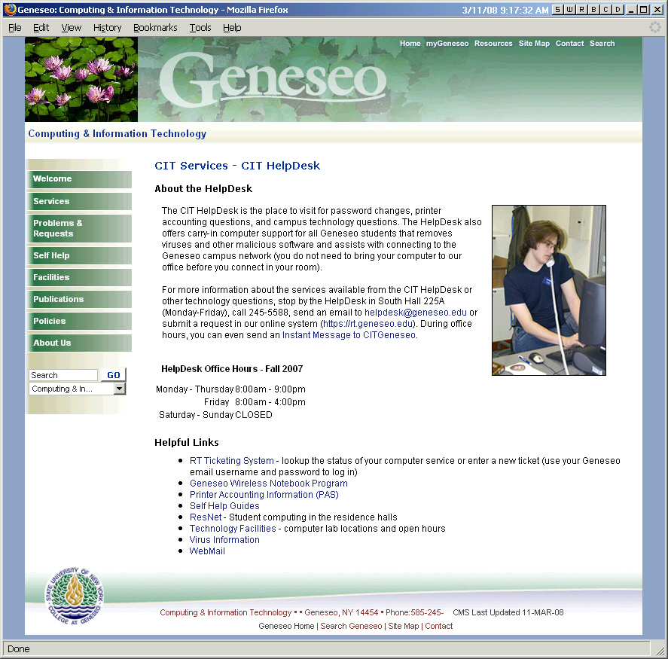
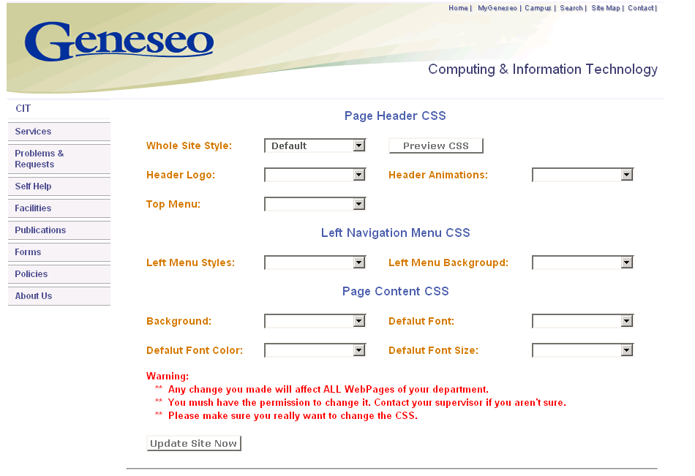
4. Integrated & consistent *
Go back to the old time in 2007

Slide 10
4. Integrated & consistent **
Consistent Color Style
Pre-designed color styles for Drupal content editors
Integrated Theme Design
Pre-designed templates
Consistent CSS
Pre-designed CSS for <h1><h2><h4><h5> <p> tags, etc.
Consistent Page Layout
Consistent Global Navigation Menu System
Consistent Header and Footer
Integrated Sub-Site Navigation Menu

Slide 11
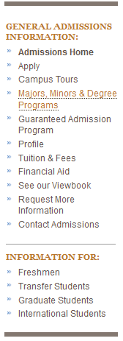
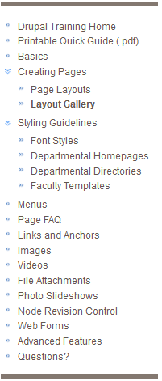
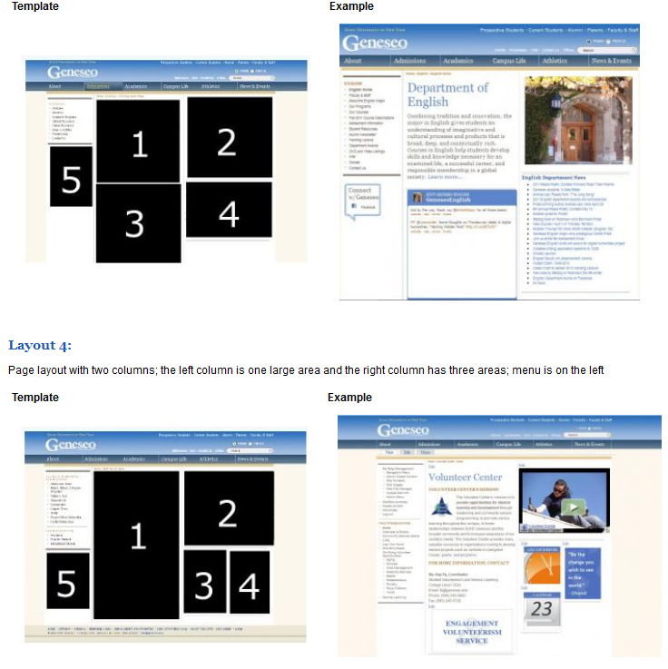
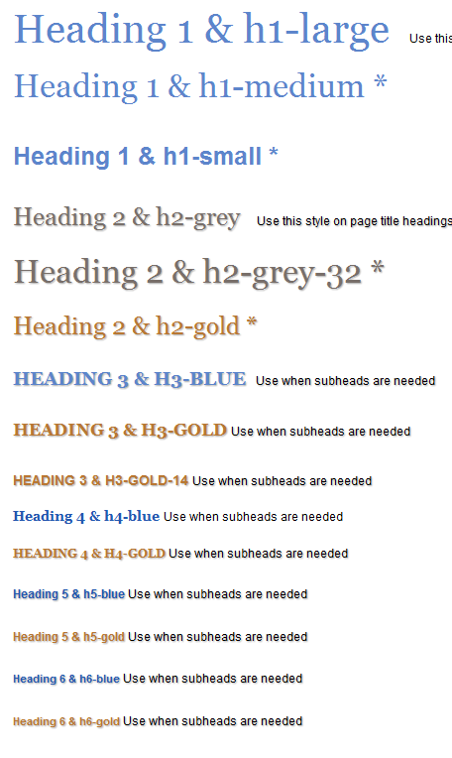
4. Integrated & consistent ***
Consistent Color Style
Integrated Theme Design
Consistent CSS
Consistent Page Layout
Consistent Global Navigation System
Consistent Header and Footer
Integrated Sub Sites Navigation Menu

Slide 12
4. Integrated & consistent ****
Single Mysql Database Instance / Schema
Not Drupal multiple installations with multiple DB instances
Share the same database instance
One Data Source Center for all Applications
Mysql Cluster Database Server
Performance
Share The Same Code Base
Share All Modules
Share All Templates
Share All Functionality

Slide 13
4. Integrated & consistent *****
Permission and Access Control
SUB SITE : Department, Office, Program, Organization, Project Website
Sub Site Role Permission Control
Create a new sub site, also create a new ROLE permission
Make sure users of admission office can NOT change any content of Math department site
ONE Content Type For ONE Sub Site
Content Type Permission Control
Navigation Menu Permission Control

Slide 14
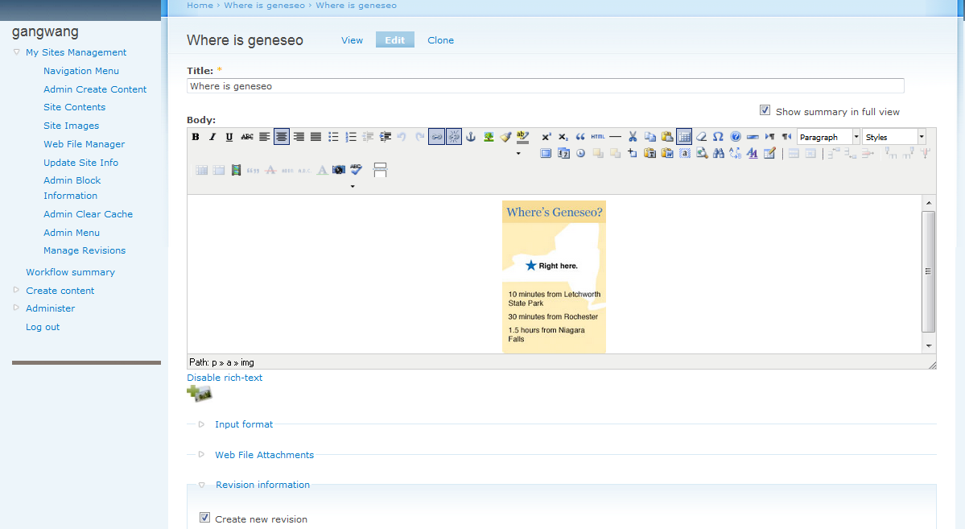
UI for Content Editor
Easy to Use
Insert Image/Media
Rich-Text Editor
User Interface for Content Editor
Web File
Management
Navigation
Menu
Create
Flexible
Contents
Content Management

Slide 15
5. Theme & Template Design
Geneseo Garland Theme
Drupal admin
Sub-site management for sub-site webmasters
Rich-text editor (TinyMCE ) for Drupal content editor

Slide 16
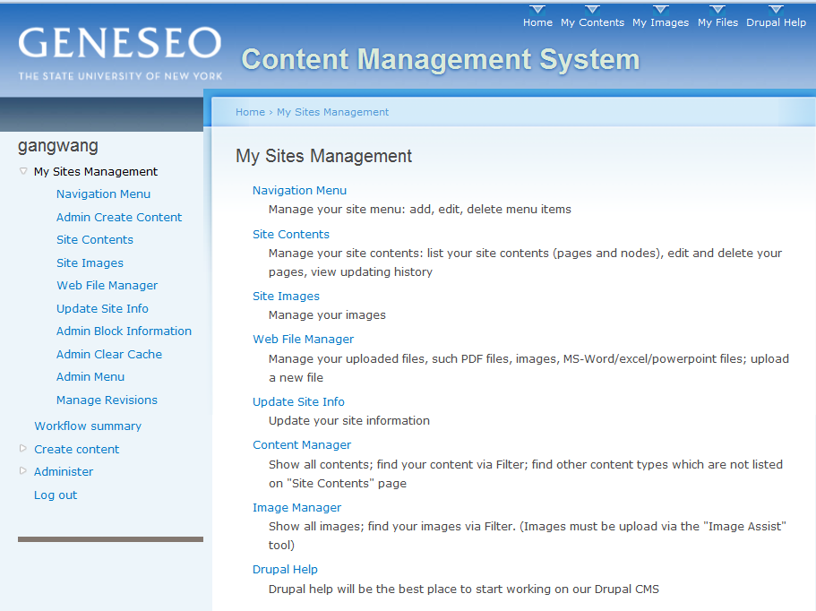
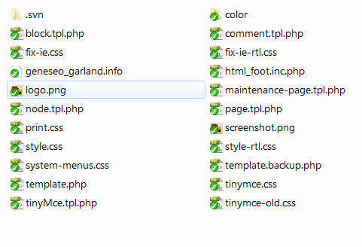
5. Theme & Template Design
Geneseo Garland Theme: Drupal PHP Templates, CSS and My Site Management

Slide 17
5. Theme & Template *
Geneseo All Theme
Main site
All sub sites except for the library site
Many customized templates
Many page layouts
Global CSS style sheets
Global JavaScript code: Jquery, Slideshow, etc.
Views templates

Slide 18
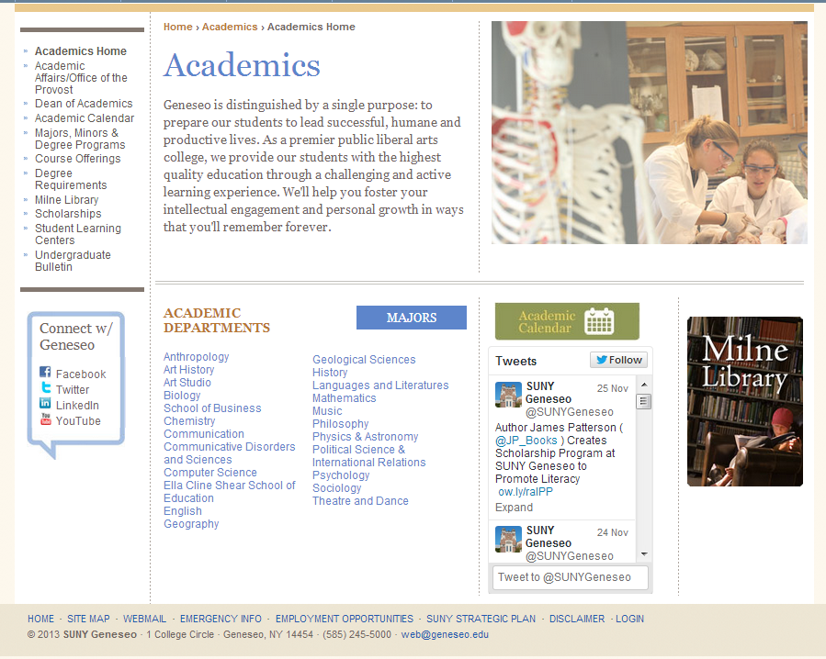
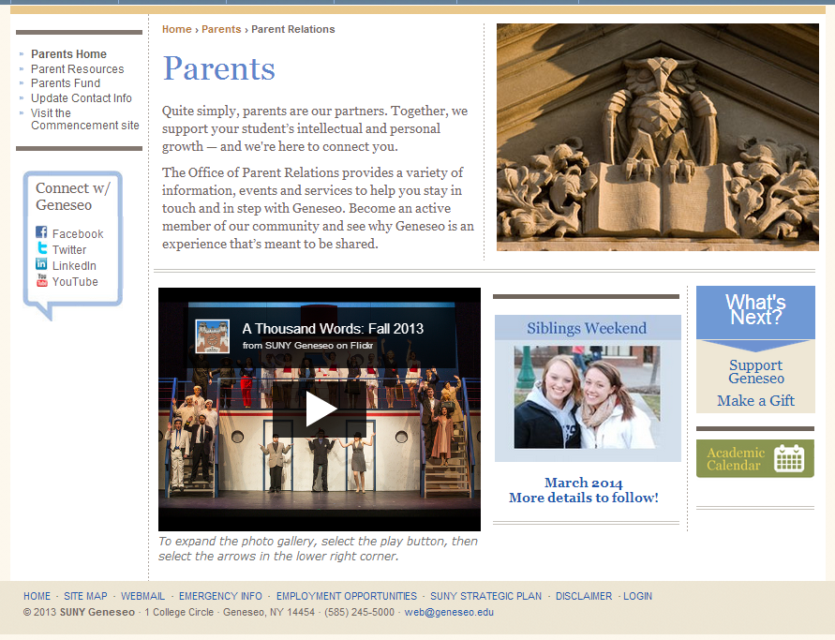
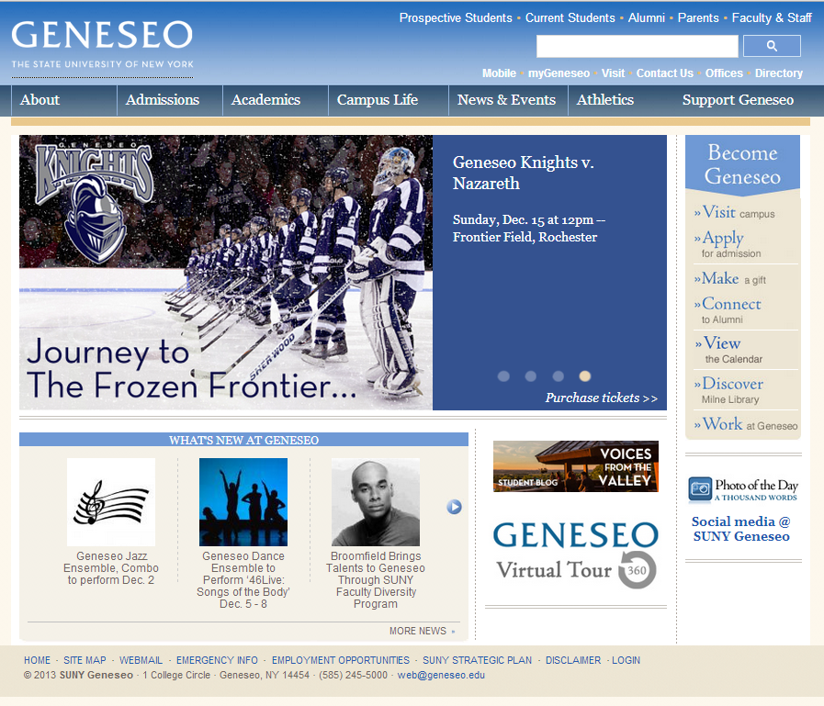
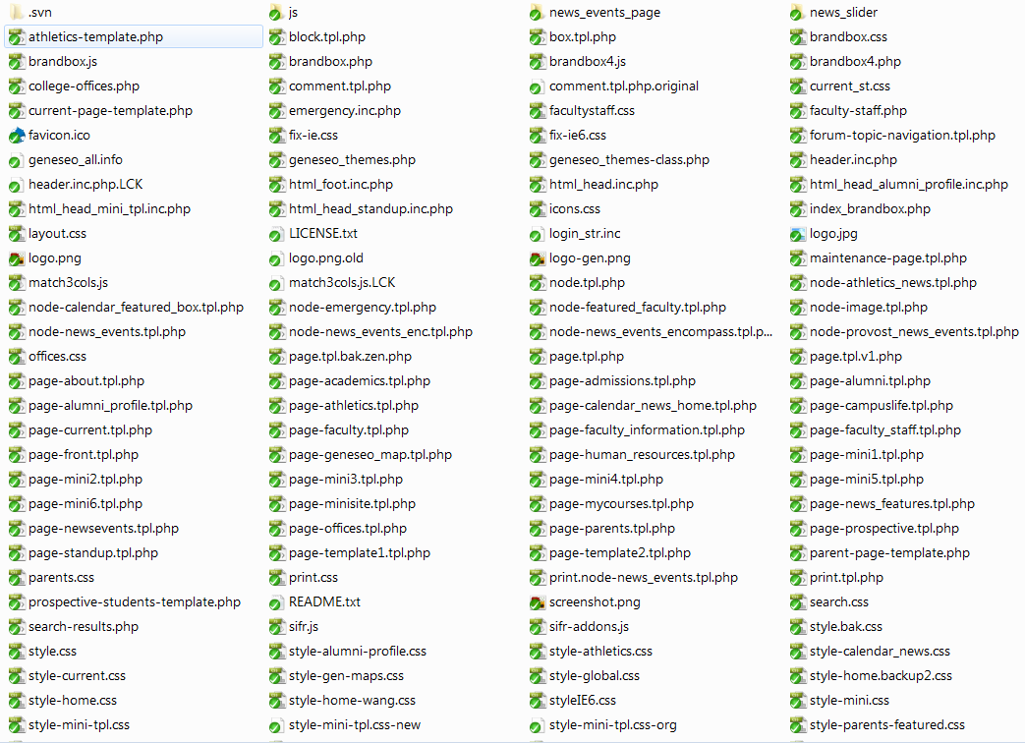
5. Theme & Template **
Geneseo All Theme
Templates
CSS
Demo Pages

Slide 19
5. Theme & Template ***
Geneseo Library Theme
Special design with the same color style
Different header, navigation menu, layout
Geneseo Mobile Theme
Mobile pages

Slide 20
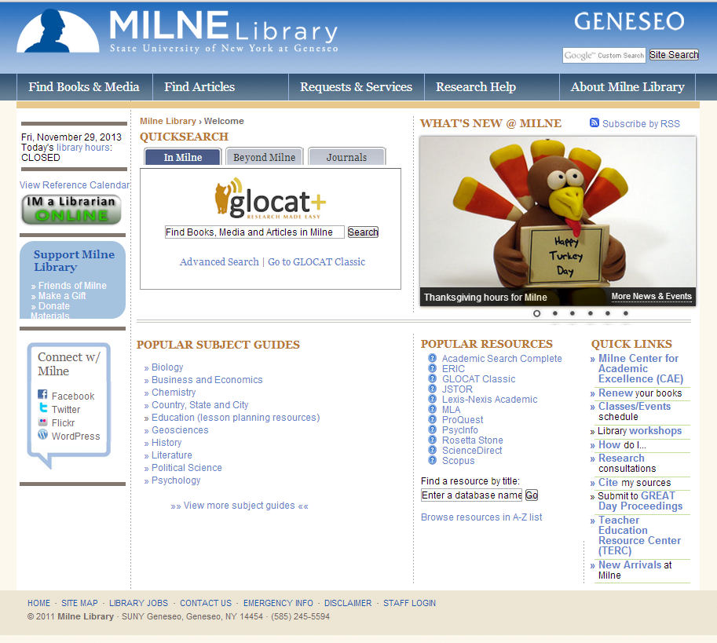
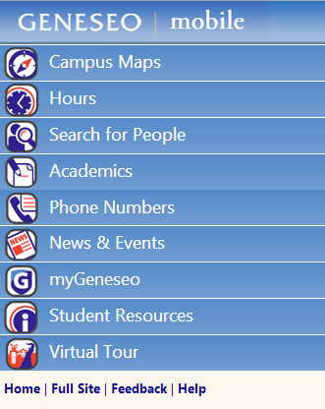
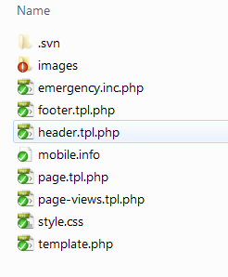
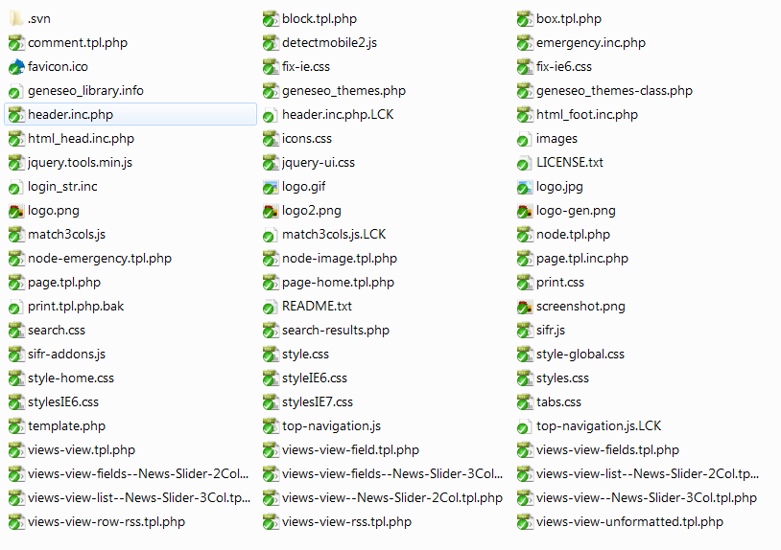
5. Theme & Template ****

Slide 21
6. Third party modules utilized?
Contributed Modules Besides of Drupal Core Modules
acl
Addtoany
advanced_help
advuser
ajax
alumni_profile
assign_depts
backup_migrate
block_manager
brilliant_gallery
browscap
by_geneseo
draggableviews
dynamicfield
faq_ask
fast_facts
feedapi
feeds
flag
front
geneseo_admin
geneseo_themes
gen_maps
Globalredirect
calendar
calendar_block
captcha
cas
cck
computed_field
connect_geneseo
contact_forms
css
cssapi
ctm
ctools
custom_breadcrumbs
date
Devel
gmap
google_analytics
iframe
Image
imagefield
image_fupload
imce
img_assist
jquery_ui
jquery_update
jstimer
late_form_alter
ldap_integration
lightbox2
link

Slide 22
6. Third party modules *
Contributed Modules Besides of Drupal Core Modules
Location
login_destination
logintoboggan
menu_block
menu_breadcrumb
menu_per_role
mini_site
mobile_tools
news_events
news_events_enco
nicer_ui
node_clone
panels
pathauto
path_redirect
print
read_rss
Scheduler
site_map
site_pages
slideshow
tagadelic
taxonomy_blocks
teaserbytype
themekey
token
views
views_calc
views_modify_query
vocabindex
webfm
Webform
webform_validation
workflow
world_war2
Wys
Wysiwyg
wysiwyg_spellcheck
How many contributed modules did we install? About 90

Slide 23
7. Customize or hack Drupal?
Never Hack Core?
“Drupal is written with the assumption that every release upgrade will overwrite every Drupal core file. Therefore, local edits ("hacks") to Drupal core files are strongly discouraged.” [www.drupal.org]
Drupal is open source
Do what you want if you have the enough knowledge
I feel it is one of the best ways to understand Drupal
We modified core modules:
Menu module to add the Group permission for sub sites
menu.admin.inc functions :
menu_overview_page(), menu_overview_form(), menu_edit_menu()
Menu.module functions :
menu_help() , menu_menu(), menu_get_menus()
Node module to add the access control for nodes
Node.module:
node_access(), node_dept_access(),
node_is_dept_access_type(), node_has_dept_access()

Slide 24
7. Customize or hack Drupal? *
Why Did We Hack Core ?
Can NOT find a good solution for the SUB-SITE design infrastructure
Sub-site permission for Navigation MENU
Different sub-site users have different access to their own nav menu
Web File Manager module needs sub-site level access
Web Form module needs sub-site level access
1
2
3
4
5
Alternative Solutions ?
Organic Groups module
Too complicated for our case
The outsource company suggested CCK
Old CMS migration problem
Groups module
Simpler than OG module

Slide 25
8. Custom modules to fill gaps
We built modules
Totally 19 Modules
alumni_profile
assign_depts
by_geneseo
fast_facts
geneseo_admin
geneseo_themes
gen_maps
connect_geneseo
Webfm
Webform
world_war2
Wys
mini_site
news_events
news_events_enco
read_rss
site_map
site_pages
slideshow

Slide 26
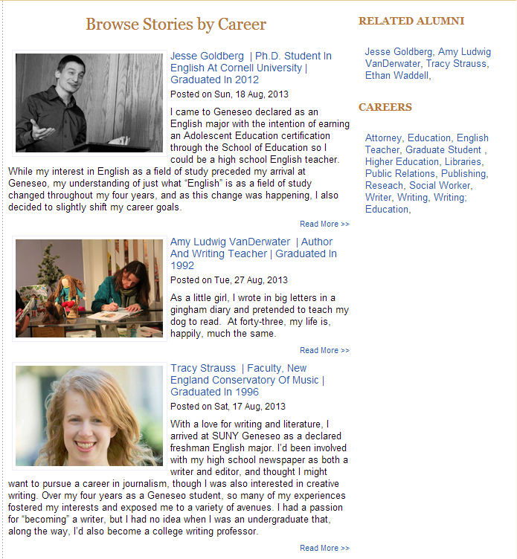
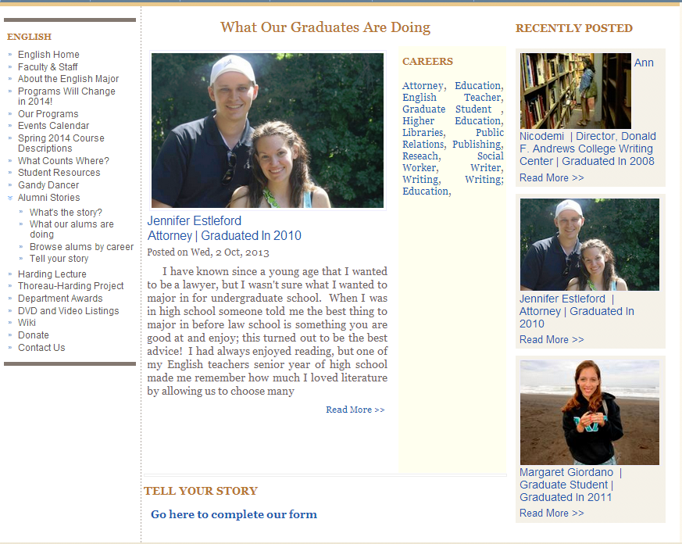
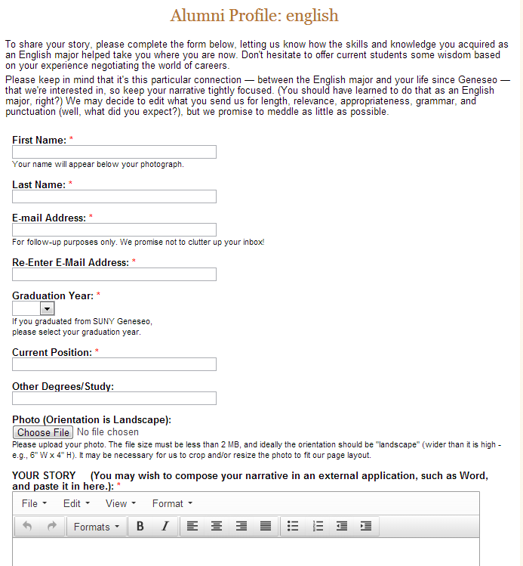
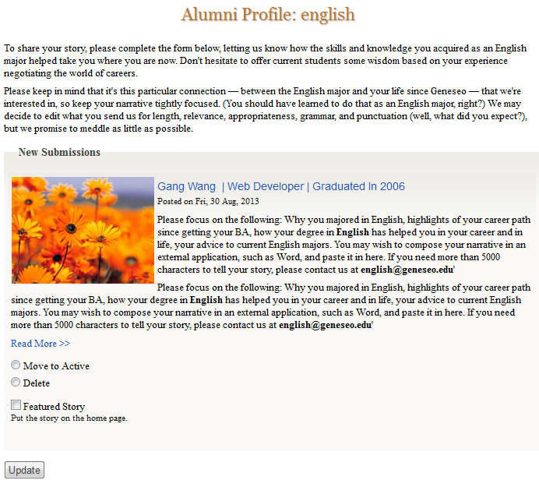
8. Custom modules *
Alumni Profile module

Slide 27
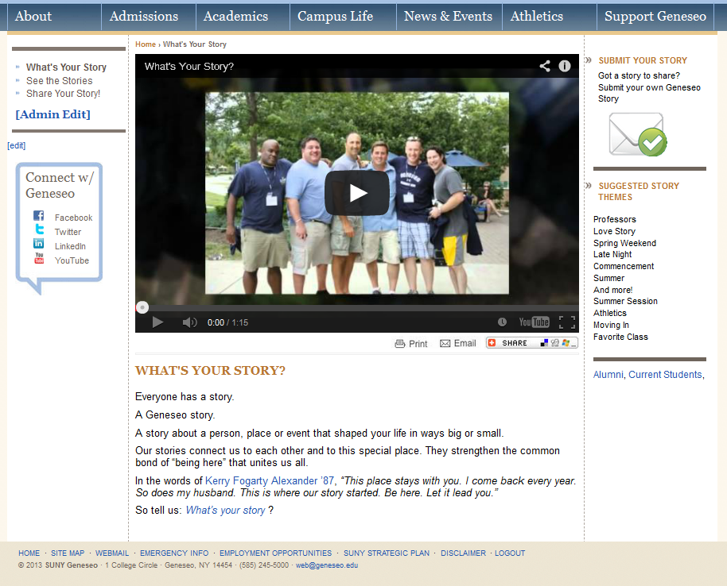
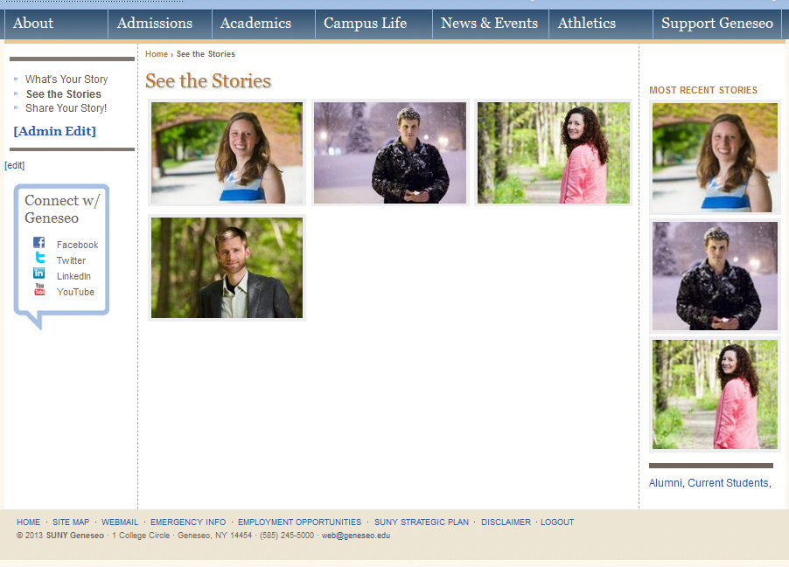
8. Custom modules **
What’s Your Story module

Slide 28
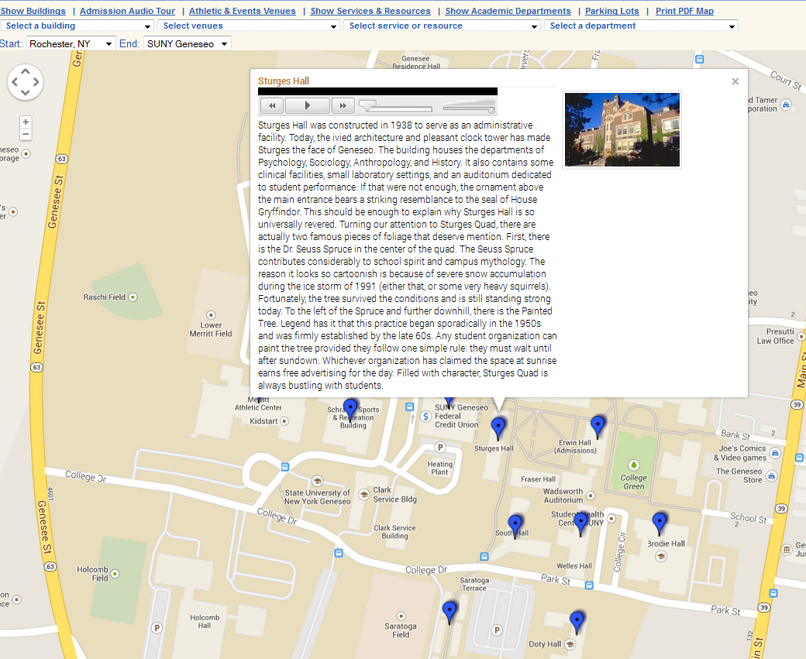
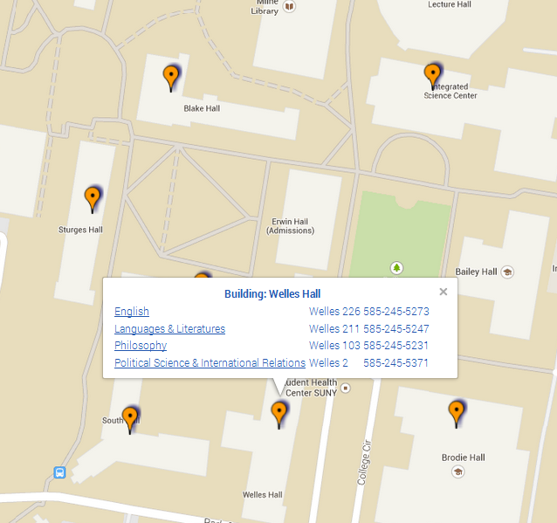
8. Custom modules ***
Geneseo Campus Maps (Google MAP API)

Slide 29
9. Successes
Migrated data from Geneseo Old CMS to Drupal 6
Implemented applications to migrate data from Oracle to Mysql
Learned and understood Drupal Database Structure
Redesigned Web Site
Drupal Theme Design and Implementation
All templates, CSS and JavaScript
Integrated all Campus Websites:
All Websites Of Departments, Offices, Organizations, Projects, Faculty Members, Etc.
Consistent Color Styles, Page Layouts, CSS for All Websites
Accomplished Our Goals
Made website appear integrated and consistent
Made one drupal installation, one database instance, one data source center
Made CMS easy to use for all campus users
Made CMS easy to maintain for CIT group
Our Drupal system is Stable and Flexible
Positive Feedbacks from Users/Editors and Visitors

Slide 30
10. Challenges
Drupal 6 Security Updates
We hacked the core and modified some modules, web file manager, web form
Very carefully test new code and customized code
Take lots of extra time and extra work for updating
Drupal 6 To Drupal 7 OR Drupal 6 To Drupal 8 Upgrade?
We built many modules, it is a pain to upgrade to Drupal 7
We are waiting for Drupal 8
Many Content Types And Navigation Menus
Each sub-site has its own content type and navigation menu
There are more than 200 content types and menus in our system
We build Geneseo admin module to make it easy to manage
Mobile Website
We didn’t consider the mobile website issue when we built our system in 2008
We built a separate mobile site for the most popular contents in 2010
Responsive design is our new project

Slide 31
Demo and Questions
Demo
www.geneseo.edu
Create/Edit node, My site management
Alumni Profile: www.geneseo.edu/alumni_profile/english
Campus Map: www.geneseo.edu/m/maps/search/m
Any Questions?
Thank You!
Gang Wang
Department of Computing & Information Technology
SUNY Geneseo

