Slide 1


One Content Type to Rule Them All
CORNELL DRUPAL CAMP 2015
Case study of “Any Page”, a single-content type implementation

Slide 2

Presenter
Will Jackson
Senior Drupal Developer
Resident Commerce Consultant
System Administrator
DevOps Engineer
Notes:
Add details on background. Will, can you add yours?

Slide 3
New Valley Media
Drupal Development and Support Company
Located in Aiken, SC
Notes:
Add details on background. Will, can you add yours?

Slide 4
Introductions
Why single-content type?
Our model: Any Page
ECK and other construction tips
The Future
Who are you?
Site builders, developers, themers, content managers, etc
Most content types
on a site?
Notes:
Add details on background. Will, can you add yours?

Slide 5
Why single-content type?

Slide 6
Problem 1: Content type overload
Advantage of Drupal: Add as many content types and fields as needed
Disadvantage of Drupal: Add as many content types and fields as you think you need
And content types are rigid!
Notes:
Question for attendees: Prize for most?

Slide 7
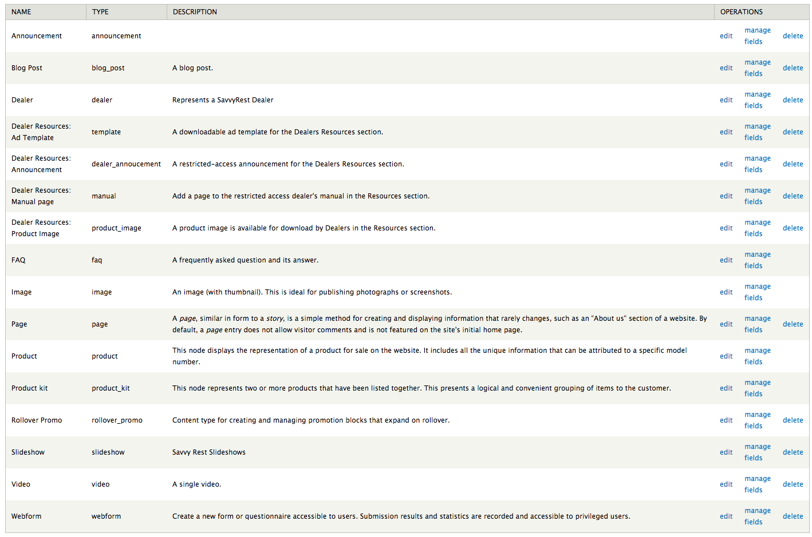
How many content types are too many?

Slide 8
Traditional Content Models
Focus on “content types.”
Assume that unique content type is needed for each page variation.
Still connect presentation to architecture.
(References:
http://pointnorth.io/#content-modeling
http://alistapart.com/article/content-modelling-a-master-skill)

Slide 9
Problem 2: Design trends
Single-page and long-form pages.
Mix of visuals: images, videos, graphics.
Editors want to control order of elements.
Mix of default and custom sidebar blocks.
Notes:
Design trend toward long, parallax scrolling pages. How can we provide editorial control?
Sometimes that page calls for a single image, other times a gallery or slideshow, other times a video. How can we provide flexibility for building these pages?
Editors don’t want to be stuck in a box or with static displays. They want to be able to reorder elements on the page.
Editors also want more control over sidebar blocks. Drupal’s block configuration makes this difficult, even when using context instead.

Slide 10
Single-content type solution:
“Any Page”

Slide 11
Single-content type solutions
Rather than content types, IA focuses on content organization.
Complex pages (such as landing pages) can be controlled by editors.
Easier flexibility for non-content regions, such as sidebars.
Notes:
IA focuses on content organization, which means fewer one-off pages fall through the cracks.
Designs are becoming more complex, with mixture of images and content blocks.
Clients want granular control over sidebars

Slide 12
Single content type: Any Page
Content model
Content type
Fields
Custom Theming
⇒ Site structure
⇒ Page type tags
⇒ Reusable blocks
⇒ Built-in style options
Notes:
Key differences between Any Page and content type for each presentation type -- content models focus on site structure rather than content types, which allows laser-focus on user needs.
Instead of content types, use page type tags.
Instead of an unending list of fields, implement reusable blocks.

Slide 13
Example: Events
Content type:
Title
Date
Location
Description
Type of event
Registration form
Photo, gallery, video
Speakers
Handouts
Single content type:
Title
Tag: Event, Types
Blocks:
Event, Text, Image, Video, Person, Doc Attachments, etc.
Notes:
Conventional content type: starting adding fields. And even after adding fields, typically locked into a static layout.
Single content type: Core fields, then flexible blocks. Event block includes date/time and location. Reusable, can be reordered.

Slide 14
Any Page: Module magic
STRUCTURE
Entity Construction Kit
Entity Reference
Inline Entity Form
Context, Features
Views, View Field
Media
Automatic Entity Label
UX ENHANCEMENTS/PRESENTATION
Field Group
Multiple Selects
Display Suite / Extras
Fields Conditional
Field Formatter Settings
Field Formatter Conditions
Notes:
WILL: Can you flesh out this list? List modules in order of importance.

Slide 15
Entity Construction Kit
Create/Manage entities and bundles from UI.
Manage properties and custom behaviors.
Create bundles to share entity configuration.
Thousands of compatible modules (Field UI).
Notes:
WILL: Can you provide an overview of ECK, how it works, etc. Add supporting slides as needed.

Slide 16
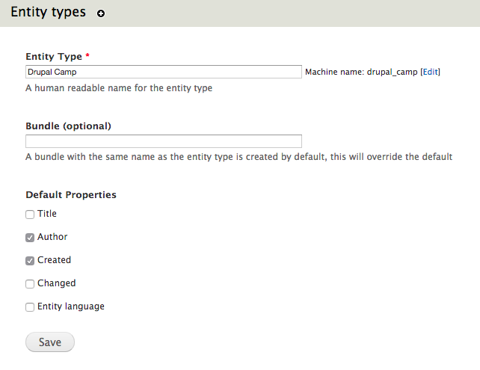
Entity Construction Kit
Notes:
WILL: Can you provide an overview of ECK, how it works, etc. Add supporting slides as needed.

Slide 17
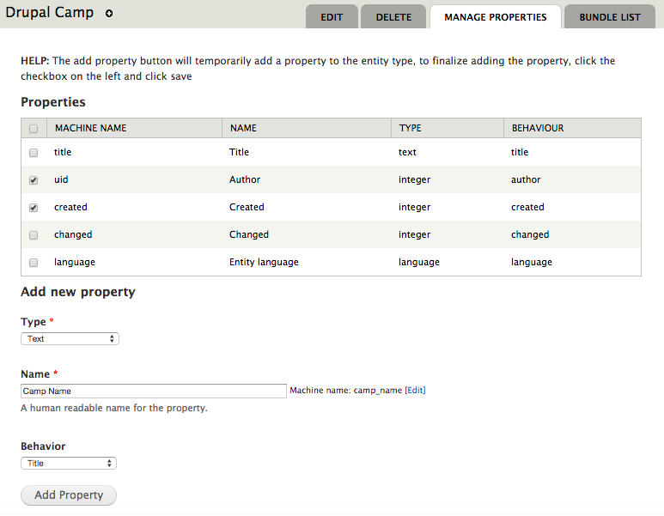
Entity Construction Kit
Notes:
WILL: Can you provide an overview of ECK, how it works, etc. Add supporting slides as needed.

Slide 18
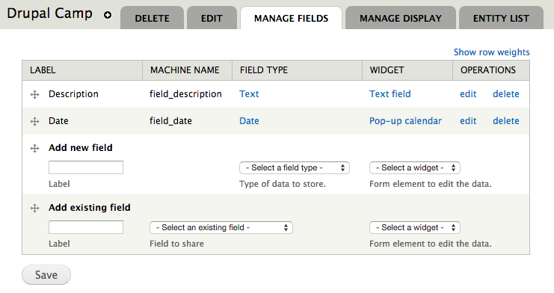
Entity Construction Kit
Notes:
WILL: Can you provide an overview of ECK, how it works, etc. Add supporting slides as needed.

Slide 19
Alternative tagging: Options entity
“Options” entity type with two bundles
Option Type: parent, such as Page Type
Option: child, such as Event, Blog, Product, News, etc.
Also used for supporting options in the Any Blocks: Layout Options, Link Style, Image Style, Color Scheme, etc.
Notes:
Before we talk about fields in the Any Page content type, let’s look at a supporting entity type: Options

Slide 20
Option fields
Label: human-friendly description
Machine name:
  CSS-friendly string
  Applied as classes to streamline theming
  Related to Bootstrap classes or variables
Example - Block Color Scheme:
  Label: Purple background / white text
  Machine name: color_brand_contrast_white
Notes:
Before we talk about fields in the Any Page content type, let’s look at a supporting entity type: Options

Slide 21
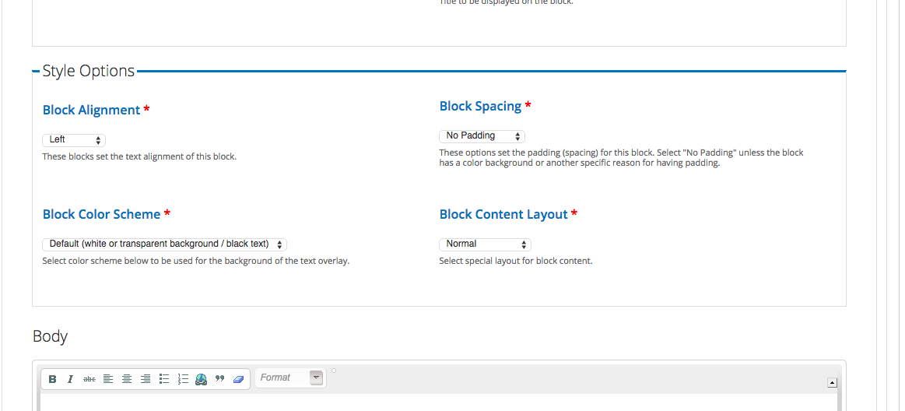
Option Types in use on Text Block style options

Slide 22
Any Page node fields
Title
Tags: Page type, categories
Teaser and teaser image
Entity reference fields:
  Main content
  Left sidebar
  Right sidebar
  Content top
  Content bottom
Default globals
Notes:
Core fields on Any Page content type: title, tags (using Options entity reference), teaser and teaser image. Then the meat of Any Page: entity reference fields. Our structure is based on the regions in our standard page template.

Slide 23
Any Page node fields
Title
Tags: Page type, categories
Teaser and teaser image
Entity reference fields:
  Main content
  Left sidebar
  Right sidebar
  Content top
  Content bottom
Default globals
Notes:
Core fields on Any Page content type: title, tags (using Options entity reference), teaser and teaser image. Then the meat of Any Page: entity reference fields. Our structure is based on the regions in our standard page template.

Slide 24
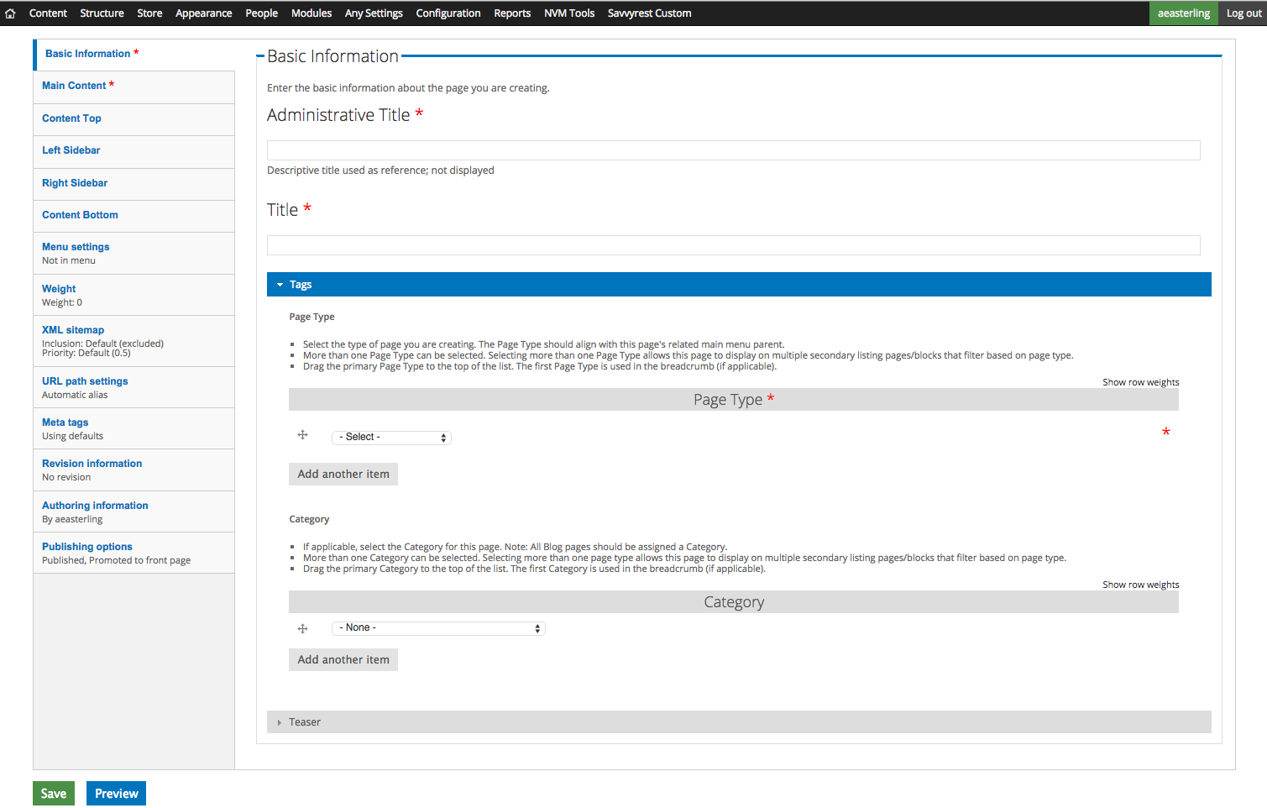
Page Type tag is alternative to separate content types. Can be changed as node usage changes.
Other functional or presentation tagging can be added as needed.
Notes:
Tags instead of page types. Allow multiple page type tags.

Slide 25
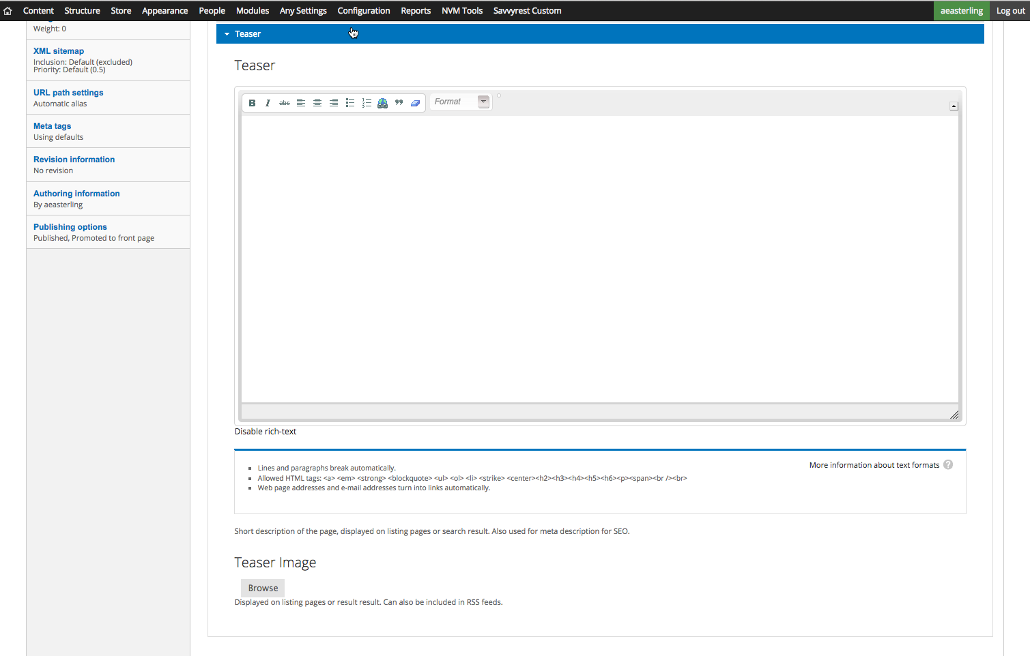
Recommend using Teaser because there is no standard Body field to use as a fallback.
Notes:
Teaser: recommend requiring since there’s no body field to use as fallback for teaser.

Slide 26
Any Block types
Each type based on functionality.
Most block types can be used in any field. (AKA page region: main content, sidebar, etc.)
Limited field reuse.
Notes:
Now, we’ll turn our attention to the Any Blocks, the entities that are referenced in the Entity Reference fields.

Slide 27
Any Block types
Text block
Accordion block
Contact block
Document Attachments block
Event block
Featured Media block
Form block
Image (grid / slideshow)
Link (menu-style)
Location block
Product
System block (blocks from core and modules)
Video block
View / List block (blocks from Views)
Notes:
Except for Text block, each is focused on a single bit of functionality.

Slide 28
Any Block: Text block
Administrative Title
Display Title
(with optional link)
Style Options
(alignment, padding, color, layout)
Body
Image
  Options
  (style, position, link)
  Image
  (base and hover)
Links
  Link style
  (text or button)
  Title (optional link)
  Links
Notes:
Add features on text block, the workhorse of Any Page.

Slide 29
Inline Entity Form
Created by the Commerce Guys for Commerce Kickstart.
Create referenced entities inline without leaving the form.
Integrate with any new or pre-existing entity.
Streamline content forms
Notes:
WILL: can you add details on how it works, considerations in use, configuration, etc? Feel free to add supporting slides.

Slide 30
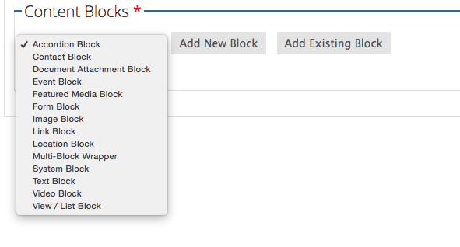
Inline Entity Form
Notes:
WILL: can you add details on how it works, considerations in use, configuration, etc? Feel free to add supporting slides.

Slide 31
Life cycle of a page
Announcement: Text, images
Event: Retag. Add Event, Location blocks
Report: Retag. Add Video block.
Resource: Retag. Add Document Attachment block.

Slide 32
Technical considerations
Performance
  Complex configurations may be resource intensive.
Commerce
  Additional customization required for contrib displays
Search
  Contributed Module Limitations
Notes:
WILL: can you add information on technical considerations, such as performance, search, commerce, data integrity

Slide 33
Review
Advantages of a single content type
  Content that evolves to what you need
  Simplify the process for content editors
Condense Content Types
  Solve the problem of “a content type for everything”

Slide 34
Questions
Are there any questions?
@willjackson00

Slide 35
Demonstration
Notes:
Anypage Demo: http://bcns:bcnsdev@fldrupalcamp.bcns.devops.ourdrop.com/
Any Page content type
Review Entity reference fields
Note default fields for sidebars and content top
Briefly review display
Introduce two entity types
Any Block bundles
Review Any Text block: show fields groups, usability for content editor, layout and styling options for each group
Review Any Text display: use of Display Suite, different display modes available for regions and/or views

Slide 36
SCREENSHOTS

Slide 37
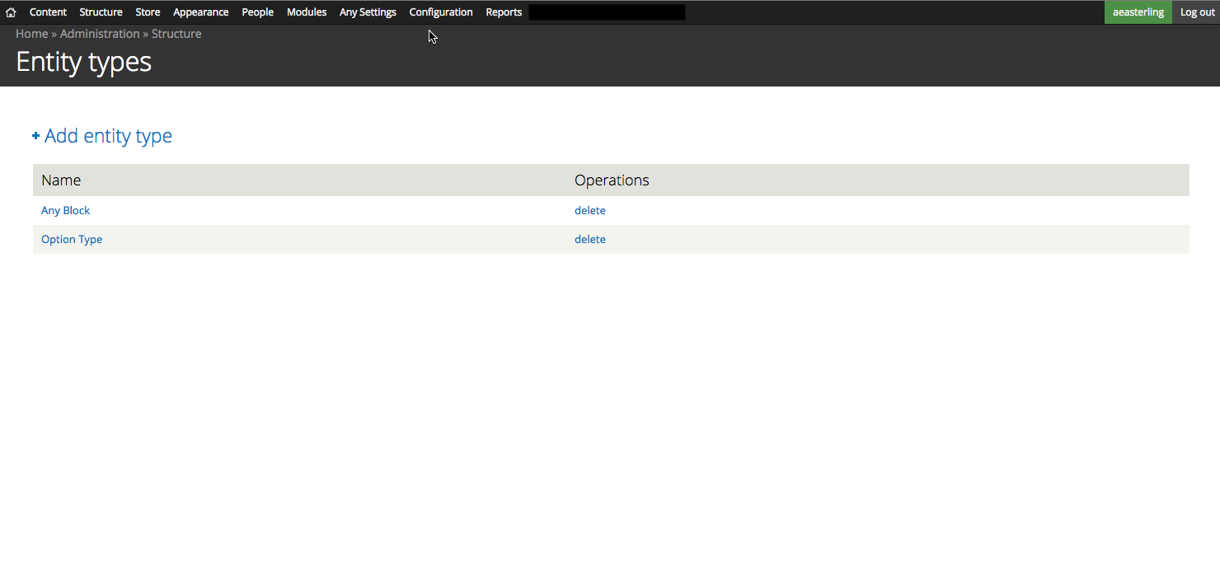
Any Page uses two custom entity types: Any Block and Option Type
Two custom entity types

Slide 38
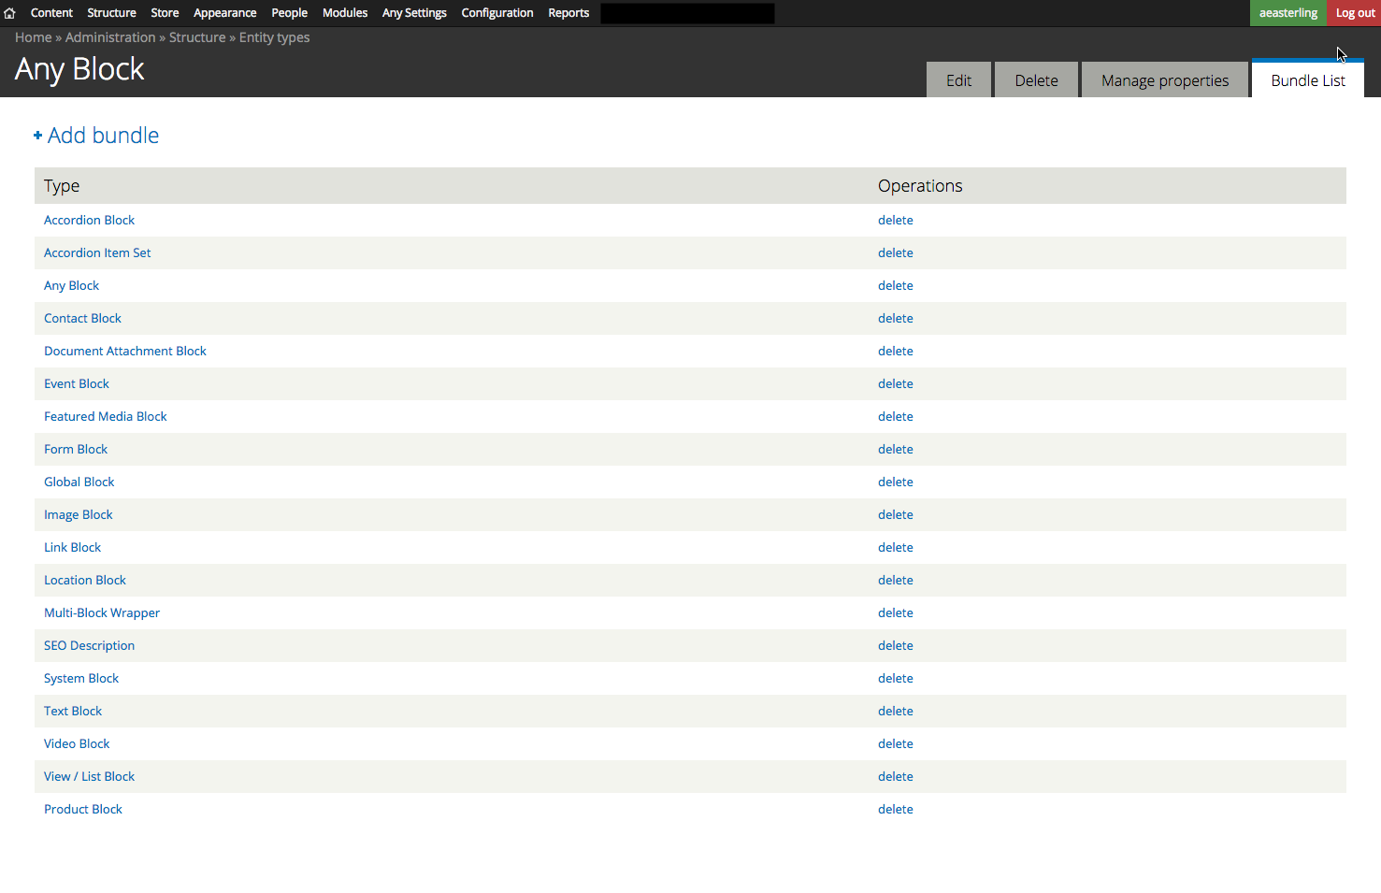
Any Block bundles
Any Block: parent bundle
Text Block: multi-purpose “workhorse” also includes image and links
Accordion Block: primary field is multi-field Accordion Item Set.
Multi-Block Wrapper: allows other blocks to be displayed in one row.
SEO Description: not available as block; used separately.
Related: Item Sets
used in block
Parent Bundle (no blocks)
Container block
Special Purpose
“Workhorse”

Slide 39
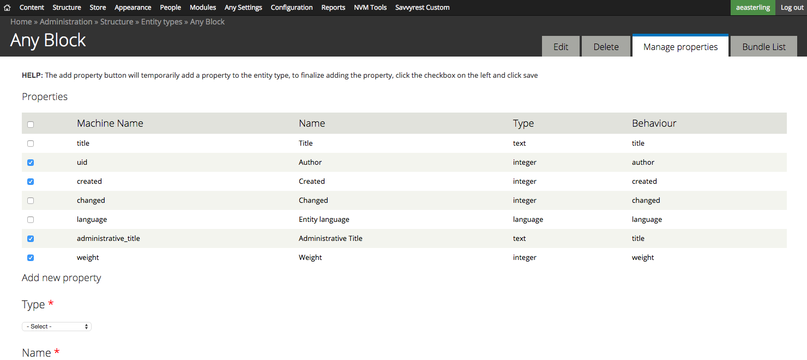
Administrative Title (instead of Title) for easier labeling
All bundles have separate Display Title field
Any Block properties

Slide 40
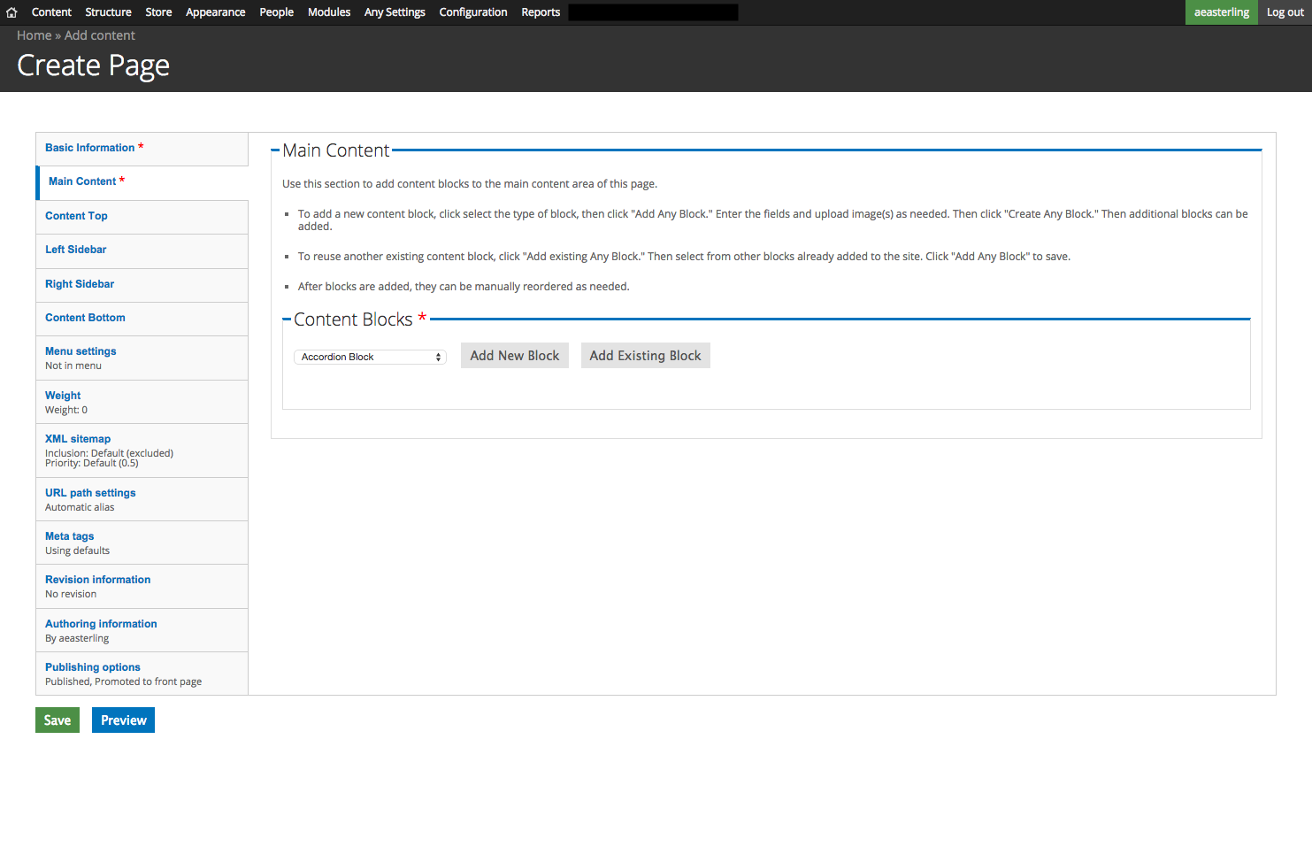
Create or reuse entities in this region.
All blocks are displayed in a vertical stack.
Main content field

Slide 41
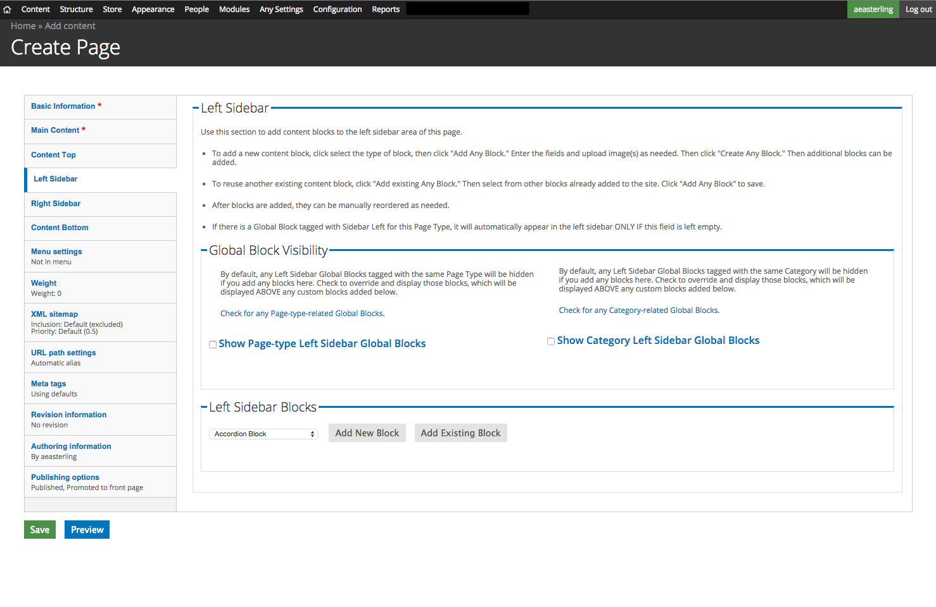
Option to override default display settings on Global sidebar blocks.
Create or reuse entities in this region.
All blocks are displayed in a vertical stack.
Left sidebar field

Slide 42
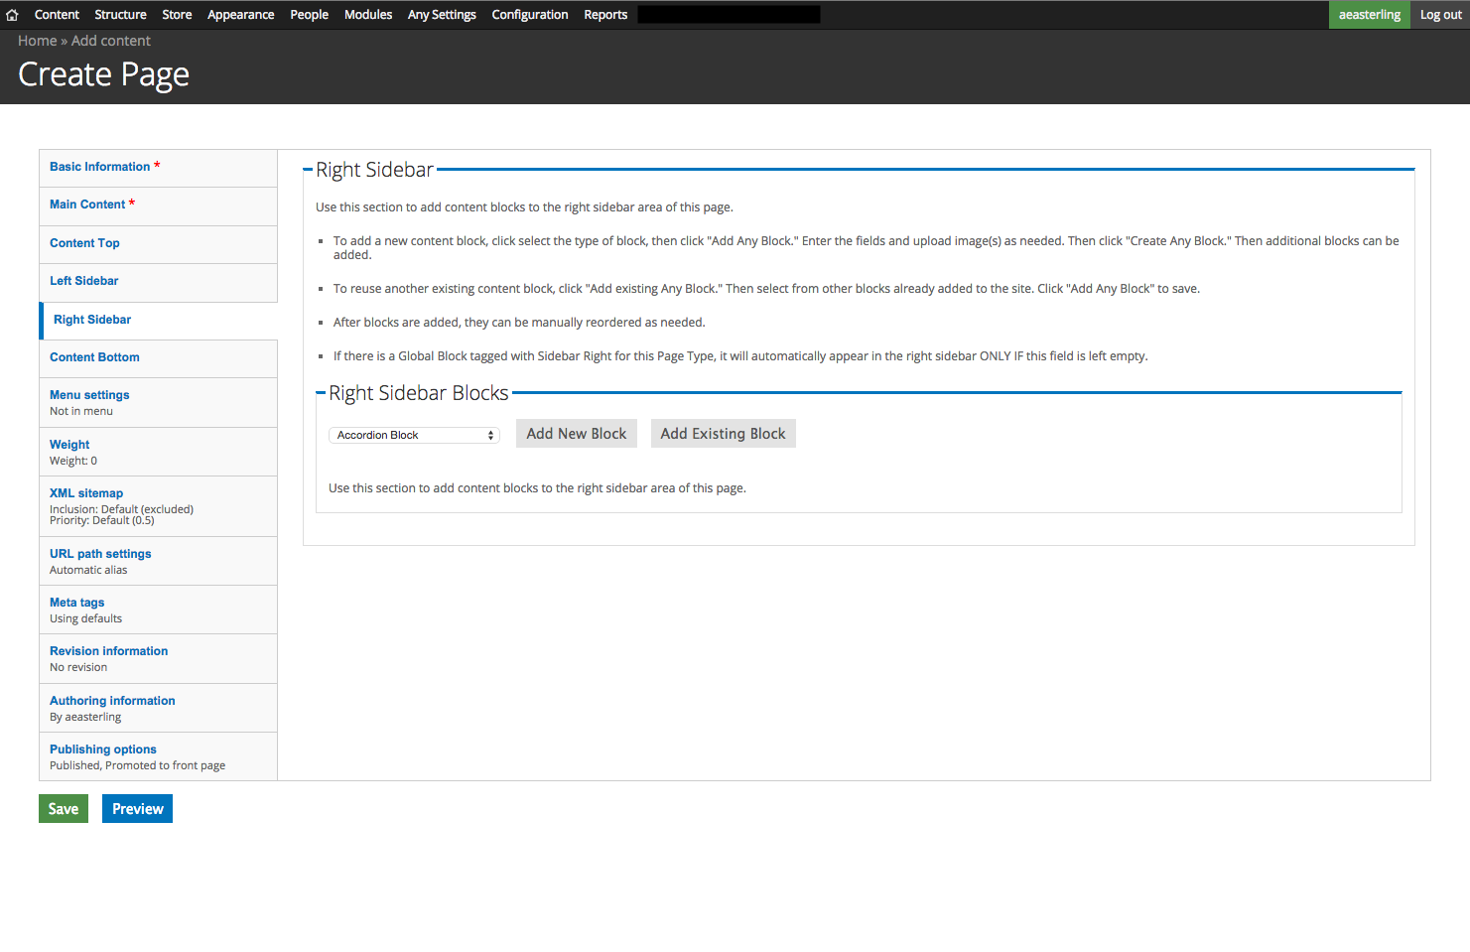
Create or reuse entities in this region.
All blocks are displayed in a vertical stack.
Right sidebar field

Slide 43
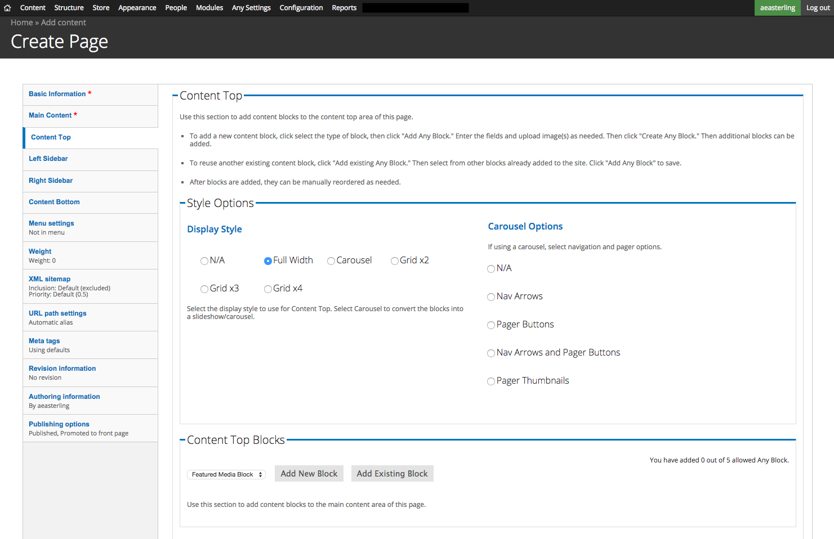
Display options for blocks displayed in Content Top region.
Create or reuse entities in this region.
Content top field

Slide 44
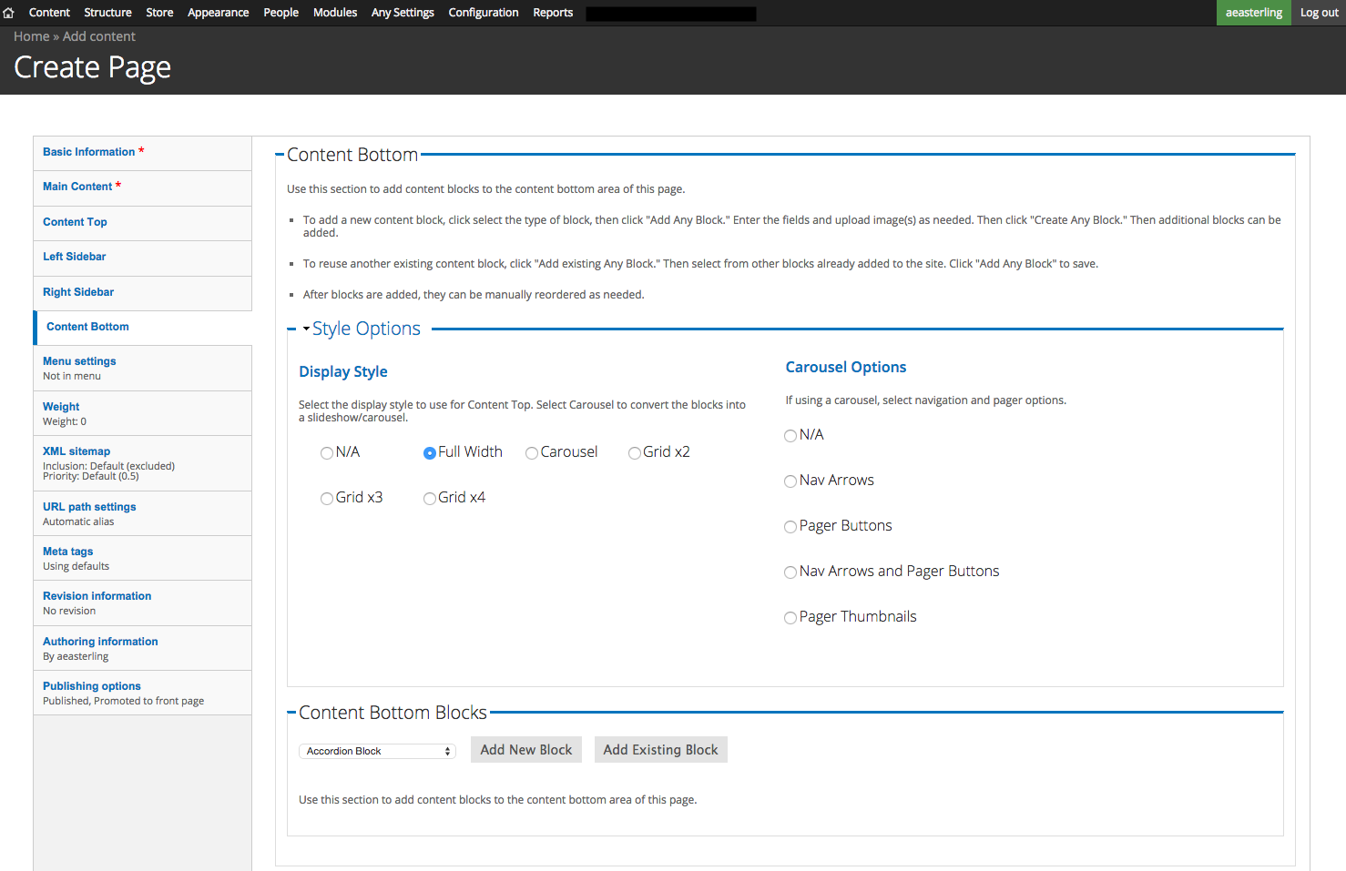
Display options for blocks displayed in Content Bottom region.
Create or reuse entities in this region.
Content bottom field

